Slide 1
Bad Designs
A Manufacturing Perspective
Computer Integrated Manufacturing
© 2013 Project Lead The Way, Inc.

Slide 2
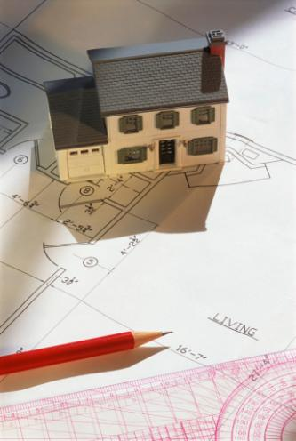
Four Factors of Design
Economy
Safety
Functionality
Ethics
Notes:
The following slides will discuss how these design factors play a part in design.

Slide 3
Economy
Cost of material
Amount of material used
Cost of labor
Notes:
Manufacturers of some copiers have changed from metal parts to plastic parts because they are cheaper.
When a product uses a part multiple times, it is cheaper if the parts are all the same size. For example, when constructing furniture, using the same size screw for all connections is cheaper than using varying sizes.
A worker with experience and education may provide better quality work, but may also have a higher salary. In addition, automation can reduce the amount of laborers needed to manufacture a product.

Slide 4
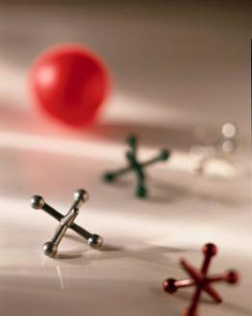
Safety
Age-appropriate
Environment-appropriate
Notes:
Fast-food restaurants offer toys in their meals for children. They must also offer an alternative to very young children (under the age of three) due to the small parts that could become choke hazards.
Environment appropriateness includes water resistance, electrical compatibility, interference of other obstacles, etc. For example, the cup holders in a car should be placed an appropriate distance from the radio so that they do not interfere with the radio’s operation. A clock that claims to be pool-side implies that it may be weather-proof when in fact it may only be weather-resistant.

Slide 5
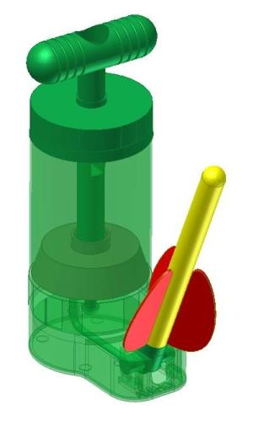
Functionality
Durability
Life span
Notes:
The toy on the right will work – about three times. Then the inexpensive parts begin to show wear and tear. The seal on the canister breaks, the air tube pops out, or the rocket holder breaks off. However, the cost was less than a dollar, and the toy would last for a birthday party.

Slide 6
Ethics
Environmentally friendly and safe
Honest
Competent
Supportive
Notes:
According to the Engineering Code of Ethics, engineers will uphold and advance the integrity, honor, and dignity of the engineering profession by:
Using their knowledge and skill for the enhancement of human welfare
Being honest and impartial with the public, their employers, and clients
Striving to increase the competence and prestige of the engineering profession
Supporting the professional and technical societies of their disciplines

Slide 7
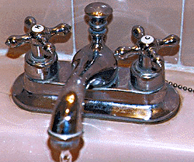
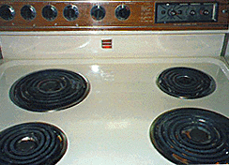
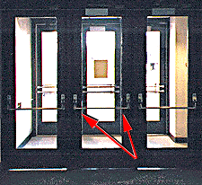
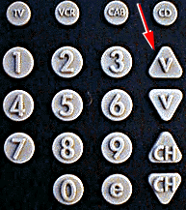
Design Flaws
1
2
Stove
Bathroom handles
3
4
Door push bar
Remote
Notes:
Consider these examples. Each has a design flaw. Can you name them?

Slide 8
Notes:
The stove controls are not arranged so that it is immediately obvious which control operates which burner.

Slide 9
Notes:
It is not obvious which way to turn the handles.

Slide 10
Notes:
Because both sides of the bar look identical, it is not obvious which side to push on to open the door.

Slide 11
Notes:
The Vs stand for Volume. At a quick glance, they look like directional arrows (both pointing down).

Slide 12
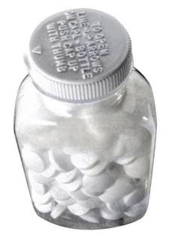
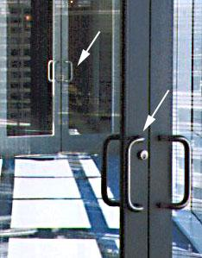
8
Refrigerator handle
6
7
Pill bottle for the elderly
Door handles
Notes:
Some more examples. Can you name the flaws?

Slide 13
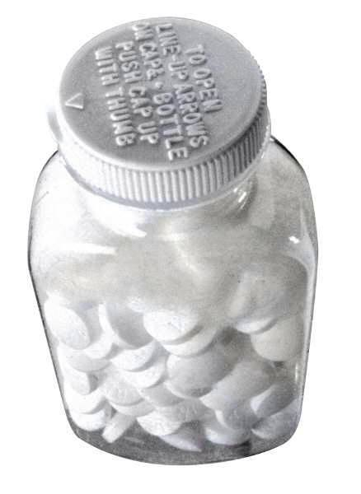
Notes:
The letters on the cap are small. In addition, arthritis is a common ailment among the elderly, and the cap would be hard to grip. It is also difficult for some elderly to manage the motor skills necessary to open the bottle.

Slide 14
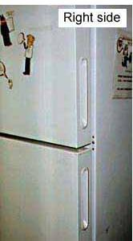
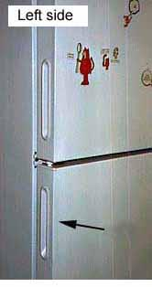
Notes:
The handles for the refrigerator and freezer are built into the side. The designer thought it would look nice to create the same look on the other side. However, this can be confusing.

Slide 15
Notes:
These doors have handles. This implies you pull them to open them. However, the inner door must be pushed open. These doors are the entrance and exit for a glass walkway; people are often “caught” between the doors because they try to pull the doors open.

Slide 16
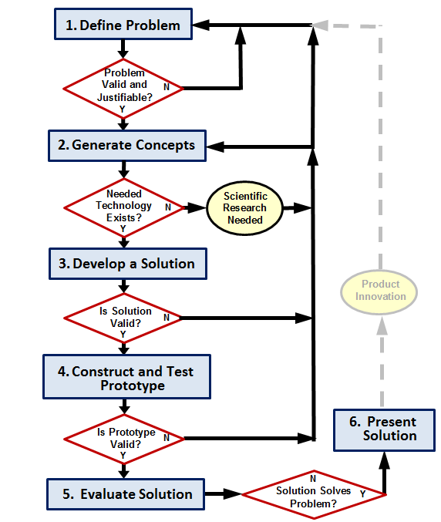
How/ Where Does This Happen?
Define the Problem
Generate Concepts
Develop a Solution
Construct and Test a Prototype
Evaluate the Solution
Present the Solution
This design process was developed based on the University of Maryland - College Park - IRB Research Project
Notes:
Flaws in manufacturing always start at the design stage. If the designer uses the design process steps and utilizes market research and evaluation, many of these flaws can be avoided prior to manufacture. Now that we have seen some bad products, we will critique some products currently at the Develop a Solution (step 3).

Slide 17
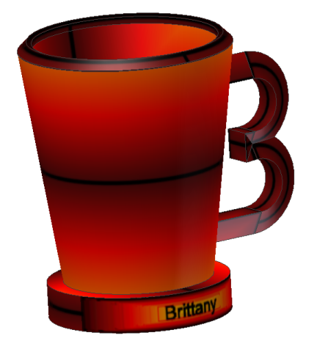
Under 3 Sippy Cup
Notes:
The design was intended to use the child’s first initial as a handle.
Problems include no lid (defeats purpose of sippy cup) and the sharp edges on the rim and handle. It is also difficult for small hands to grip.

Slide 18
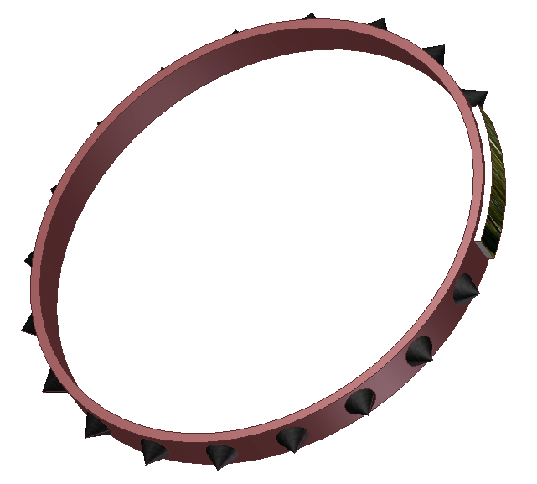
One Piece Dog Collar
Notes:
One piece design means that this will only fit one size dog. Also, if the dog becomes caught on something, it cannot get free easily. It will also be difficult to put on the dog. In addition, creation of the spikes as one piece is not feasible. This would have to be manufactured as separate pieces.

Slide 19
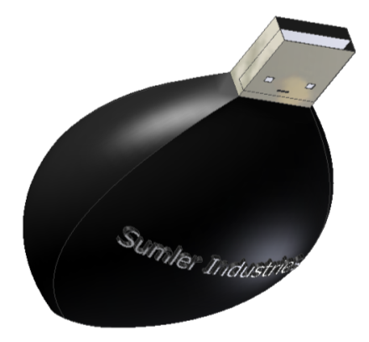
USB Drive
Notes:
This could only be used if no other neighboring port was in use.

Slide 20
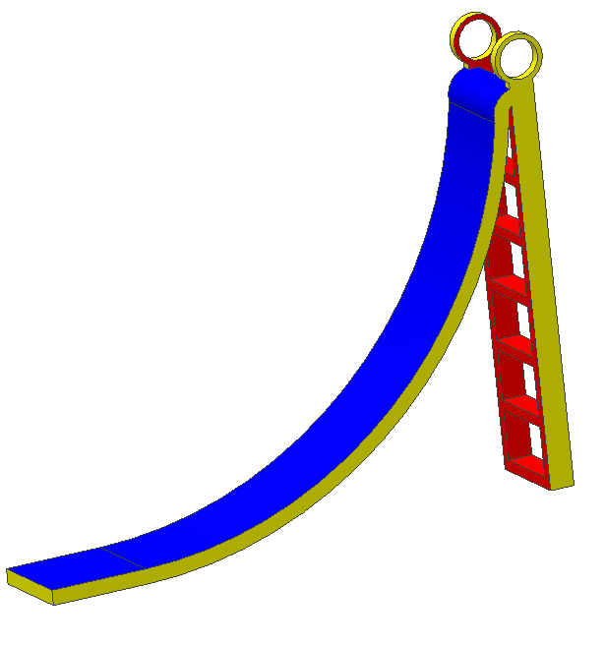
Slide
Notes:
Slide is intended for children ages 3 – 5. It would not be possible to create a slide like this all in one piece. The slide is unsafe; there are no sides to keep children from falling. The ladder is straight up. The top of the slide is too steep and the bottom ends abruptly.

Slide 21
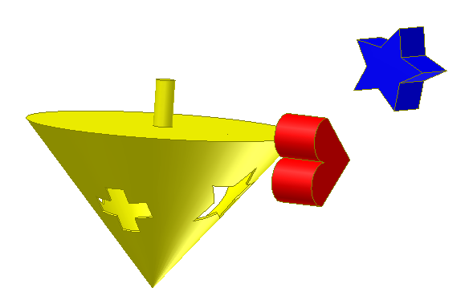
Baby Toy
Notes:
This toy is inappropriate for small children. Small parts could be swallowed. Also, storage is in a issue. Once the toys are placed inside, how do you get them out?

Slide 22
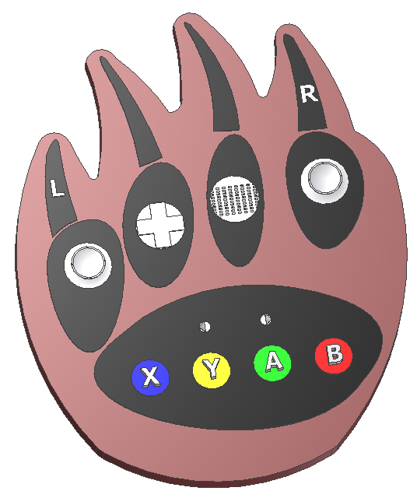
Video Game Remote Casing
Notes:
Not ergonomic. Doesn’t fit hands well. Buttons are arranged awkwardly.

Slide 23
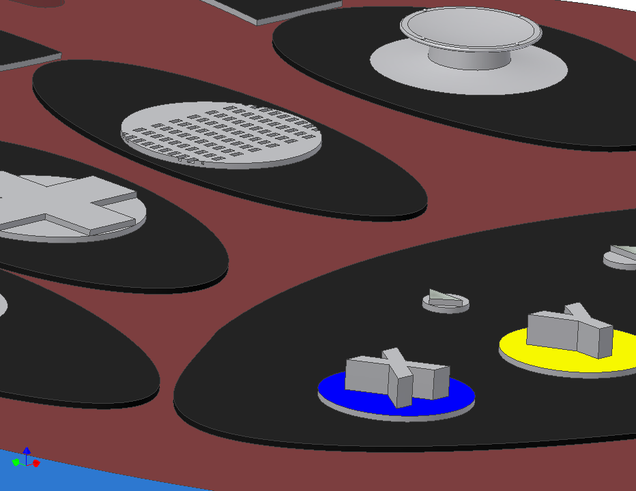
Notes:
Detail; joysticks are too short; select and start buttons unmarked; game play buttons uncovered

Slide 24
Bad Designs
Consider products that you may have encountered in your everyday life that you feel have been affected by poor design considerations.

Slide 25
Image References
Microsoft, Inc. (2009). Clip Art. Retrieved from http://office.microsoft.com/en-us/clipart/default.aspx

