Slide 1
Robotic Systems
Computer Integrated Manufacturing
© 2016 Project Lead The Way, Inc.

Slide 2
Table of Content
Robotics Subsystems
Kinematics
Cartesian Coordinate Robot
Cylindrical Coordinate Robot
Polar Coordinate Robot
Jointed Arm Robot
SCARA Robot
Robotic Control Systems
Point-to-Point
Continuous Path
Drive Systems
Sensors
Lead Screw
Accuracy Vs. Repeatability

Slide 3
Robotics Subsystems
An industrial robot is a complex, technical system consisting of several subsystems operating together
Three main subsystems are:
Kinematics
Control systems
Drive

Slide 4
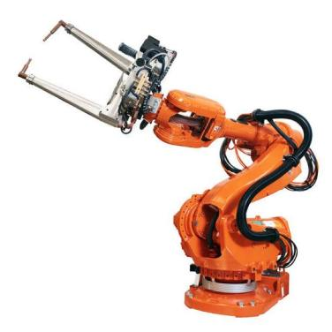
Kinematics
Kinematics is the spatial arrangement of the axes of movement in relation to one another
Basic types of movement of an industrial robot
Cartesian coordinate robot
Cylindrical coordinate robot
Polar coordinate robot
Jointed arm robot
SCARA robot

Slide 5
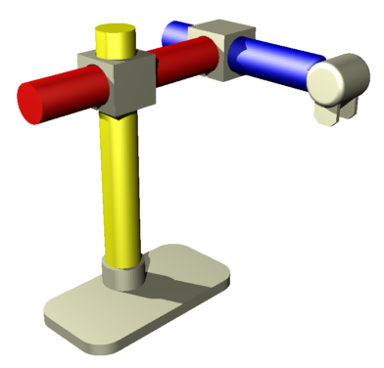
Cartesian Coordinate Robot
Consists of a column and an arm and is sometimes called an x-y-z robot (L-L-L)
X
Y
X Axis: Lateral motion
Z
Y Axis: Longitudinal motion
Z Axis: Vertical motion
Notes:
Kinematics refer to the spatial arrangement, according to sequence and structure, of the axes of movement in relation to one another. There are four basic types of movement that an industrial robot may have.

Slide 6
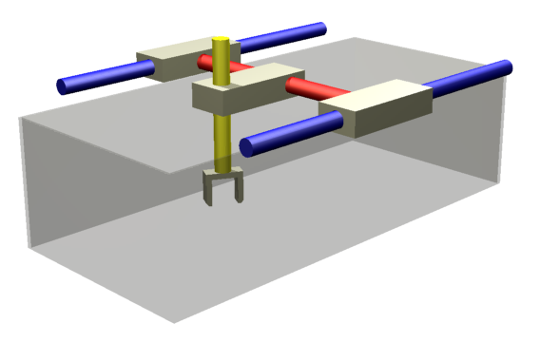
Cartesian Coordinate Robot
Cartesian or Gantry robots have a rectangular work envelope
Work envelope is the volume of space defined by the maximum reach of a robot arm in three dimensions.
Y
X
Z

Slide 7
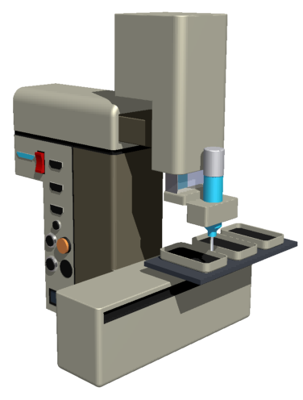
Cartesian Coordinate Robot
Typical applications
Arc welding
Handling machine tools
Most assembly operations
Application of sealant
Pick and place
Y
Z
X

Slide 8
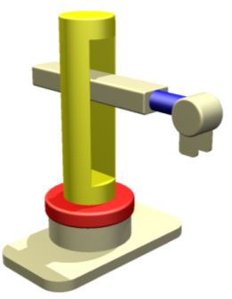
Cylindrical Coordinate Robot
Similar to the Cartesian robot. Contains a column and a base, but the column is able to rotate (L-R-L)
Y
R Axis: Rotation around the Z Axis – Base rotate
Z
Y Axis: Longitudinal motion
R
Z Axis: Vertical motion

Slide 9
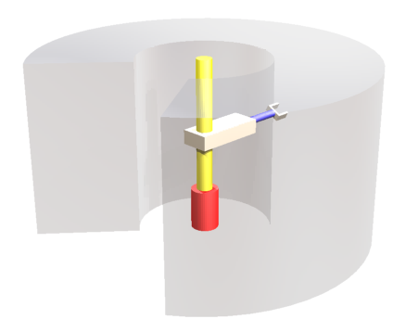
Cylindrical Coordinate Robot
Cylindrical Work Envelope
Z
Y
R

Slide 10
Cylindrical Coordinate Robot
Typical applications
Most assembly operations
Handling machine tools
Spot welding
Handling diecasting machines
R
Y
X
Z
Y

Slide 11
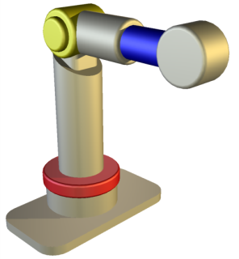
Polar Coordinate Robot
This type of robot consists of a rotary base, an elevation pivot, a telescoping extension, and a retraction boom (R-R-L)
Y
P
R Axis: Rotation around the Z Axis – Base rotate
P Axis: Rotation around the X Axis – Elevation
R
Y Axis: Longitudinal motion

Slide 12
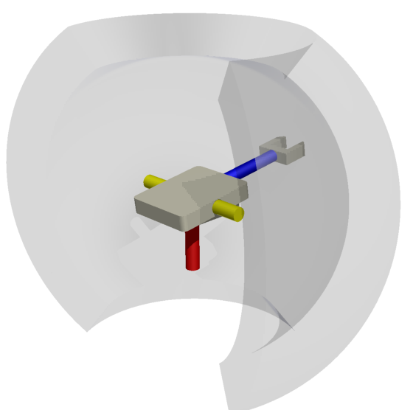
Polar Coordinate Robot
Spherical Work Envelope
P
Y
X
Y
R

Slide 13
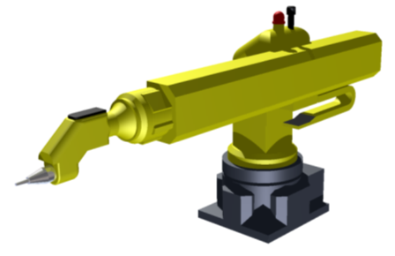
Polar Coordinate Robot
Typical applications
Handling machine tools
Spot welding
Handling diecast machines
Fettling machines
Gas welding
Arc welding
P
Y
X
Y
R

Slide 14
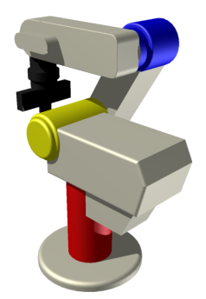
Jointed Arm Robot
This type of robot resembles a human arm. Usually stands on a rotating base and has an articulating shoulder and elbow joints (R-R-R)
J4
J3
J1: Base/waist
J2: Shoulder
J2
J3: Elbow
J4: Wrist
J1

Slide 15
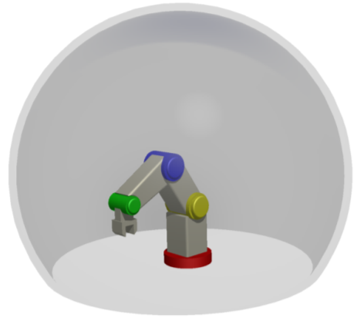
Jointed Arm Robot
Spherical Work Envelope
X
Y

Slide 16
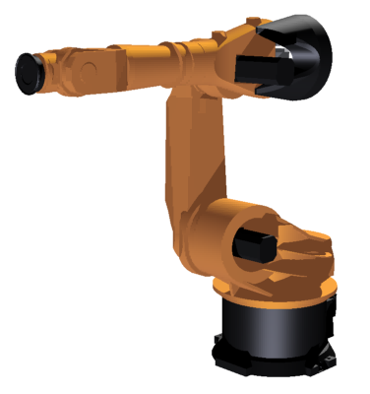
Jointed Arm Robot
Typical applications
Most assembly operations
Handling diecast machines
Fettling machines
Gas welding
Arc welding
Spray painting
J3
J4
J2
J1

Slide 17
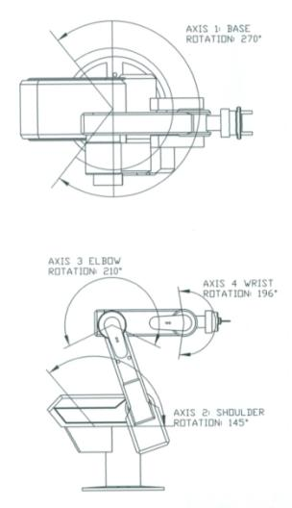
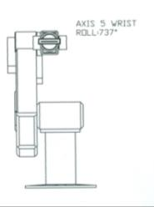
Jointed Arm Robot
Example Axis Range

Slide 18
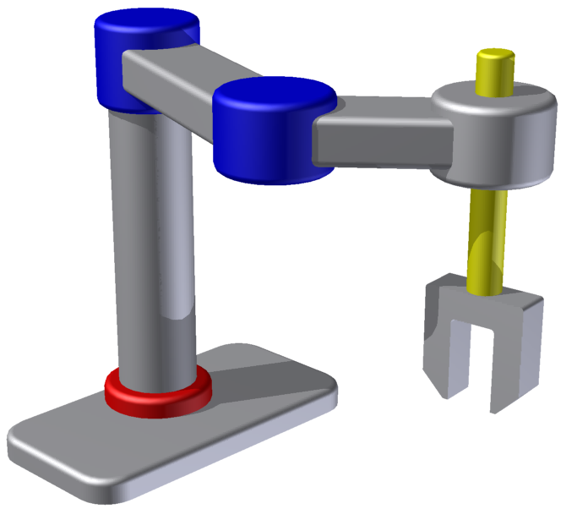
SCARA Robot
Selectively Compliant Articulated Robot Arm
Y
Y
Z
Z Axis: Vertical motion
Y Axis: Rotation creates longitudinal motion
Notes:
SCARA (Selectively Compliant Articulated Robot Arm) robots have motions very much like a human body. These devices incorporate both a shoulder and elbow joint as well as a wrist axis and a vertical motion. SCARA robots were invented in Japan in the early 1960s. The design has long since been in the public domain.
Selectively Compliant means that there are enough axes of freedom to give the joints flexibility when needed. This is necessary when the robots perform certain operations. For example, when the robot performs an insert, the axes of freedom allow the arm to “wiggle” to ensure that the two pieces fit.
SCARA robots are ideal for a variety of general purpose applications which require fast, repeatable, and articulate point-to-point movements such as palletizing & de-palletizing, loading and unloading, and assembly.
Because of their unique "elbow" motions, SCARA robots are also ideal for applications which require constant acceleration through circular motions like dispensing and gasket forming in place.

Slide 19
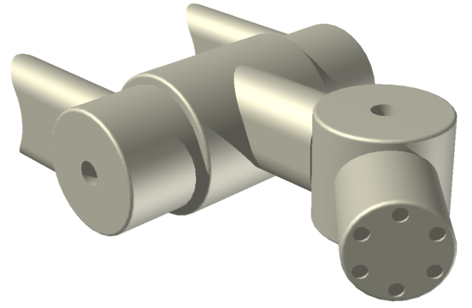
SCARA Robot
Movement of a wrist joints is commonly referred to as roll, pitch, and yaw
The arm and the wrist give the robot the required six degrees of freedom to position a tool at many orientations
Spherical Wrist
Yaw
Pitch
Roll
Notes:
The spherical wrist joint is mounted after the elbow in a SCARA.
To orientate the tools, three additional joints are required. These are normally mounted at the end of the arm in an assembly called the wrist.

Slide 20
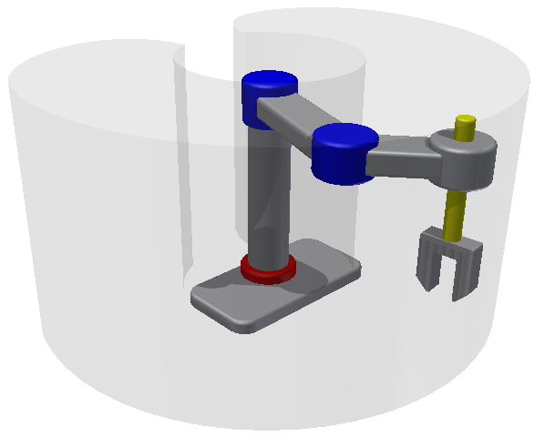
SCARA Robot
Kidney shaped work envelope

Slide 21
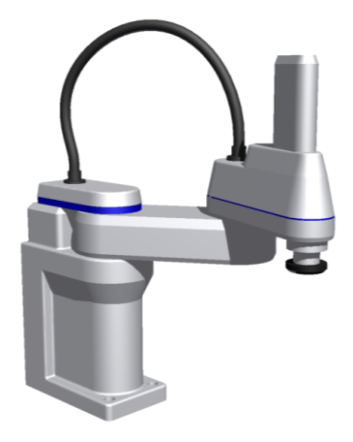
SCARA Robot
Typical applications
Pick and place
Application of sealant
Most assembly operations
Handling at machine tools
R
Y
Y
Z

Slide 22
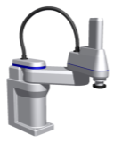
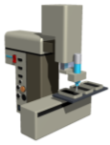
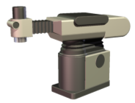
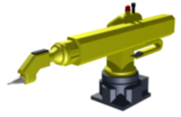
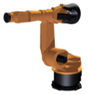
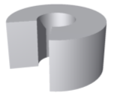
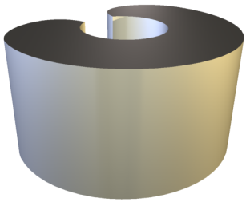
Match the Work Envelopes
A
B
C
D
E
X
1
2
3
4
5

Slide 23
Match the Work Envelopes
A
B
C
D
E
X
1
2
3
4
5

Slide 24
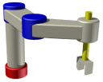
Configuration vs. Application
Pick and place
Application of sealant
Most assembly operations
Handling machine tools
Spot welding
Handling diecasting machines
Fettling machines
Gas welding
Arc welding
Spray painting

Slide 25
Configuration vs. Application
Pick and place
Application of sealant
Most assembly operations
Handling machine tools
Spot welding
Handling diecasting machines
Fettling machines
Gas welding
Arc welding
Spray painting
Y

Slide 26
Robotic Control Systems
A control system provides a logical sequence for a robot to follow.
It provides positional values required for each step of the process.
The robot then continuously checks those values to keep the system on course.

Slide 27
Robotic Control Systems
Two basic types of control systems
Point-to-Point
Continuous Path

Slide 28
Robotic Control Systems
Point-to-Point
Records beginning and ending positions
Determines the best path to take between those two points
Used when greater repeatability is required or when the specific path does not matter

Slide 29
Robotic Control Systems
Continuous Path
The robot is programmed to follow an irregular path exactly as recorded
The path is represented by many stored points close together
During the work cycle, the robot follows the points to reproduce a desired path

Slide 30
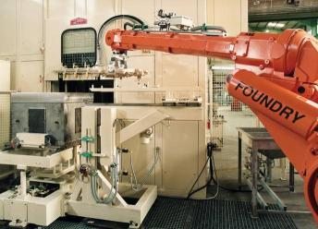
Robotics Drive Systems
Robotic drive systems are typically one of three types
Electromechanical
Pneumatic
Hydraulic
Drive systems determine
Speed of the arm
Strength of the robot
Dynamic performance
Application type

Slide 31
Electromechanical Drive Systems
Driven by
Servo Motors
Stepper Motors
Pulse Motors
Direct Drive Electronic Motors
Notes:
Servo Motor is any motor that is modified to give feedback concerning the motor's speed, direction of rotation, and number of revolutions.
Stepper Motors
Produce the highest torque at low speeds.
Have the ability to hold torque, which is not present in DC motors.
Holding torque allows a stepper motor to hold its position firmly when not turning.
This can be useful for applications where the motor may be starting and stopping while the force acting against the motor remains present.
Stepper motors "step" a little bit at a time in precise measurable increments.

Slide 32
Electrical Drive Systems
Advantage
Precise motion control
Greater strength
Disadvantage
Expensive and inefficient
High maintenance
Noisy

Slide 33
Pneumatic Drive Systems
Advantage
Uses inexpensive compressed air to operate
Good for clamping work pieces
Disadvantage
Speed and position not easily controlled

Slide 34
Hydraulic Drive Systems
Advantage
Compact
Allows for high levels of force and power, combined with accurate control
Converts forces from a liquid into rotational or linear forces
Quickly being replaced by servo-driven ball screw type systems

Slide 35
Hydraulic Drive Systems
Disadvantage
Messy. Fluid may contaminate parts, mess up other handling machines, and may not take a finish.
Not environmentally friendly – fluid can be toxic.
May require costly clean up and disposal.

Slide 36
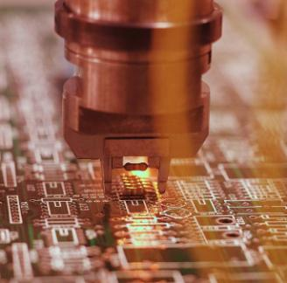
Robotic Sensors
Robot sensors provide closed loop control
Typical functions
Detect positions
Orientate parts
Ensure consistent product quality
Read part characteristics
Identify obstacles
Determine and analyze system malfunctions
Notes:
Mechanical – Measures position, torque, strain, velocity, shape, pressure, mass, vibration
Electrical – Measures voltage, current, change, conductivity
Magnetic – Measures magnetic field, flux, permeability
Thermal – Measures temperature, flux, conductivity, specific heat
Others – Measure acoustic, proximity, chemical, photoelectric, radiation, lasers, optical systems, tactile, voice, visual sensing

Slide 37
Robotic Sensors
Examples
Micro Switch
Solid-State Switch
Proximity Sensors
Photoelectric Sensors
Rotary Position Sensors
Notes:
Micro switches include manual switches, limit switches, impulse limit switches, reed switches, and pressure switches.
Rotary position sensors include encoders, synchros, resolvers, and potentiometers.

Slide 38
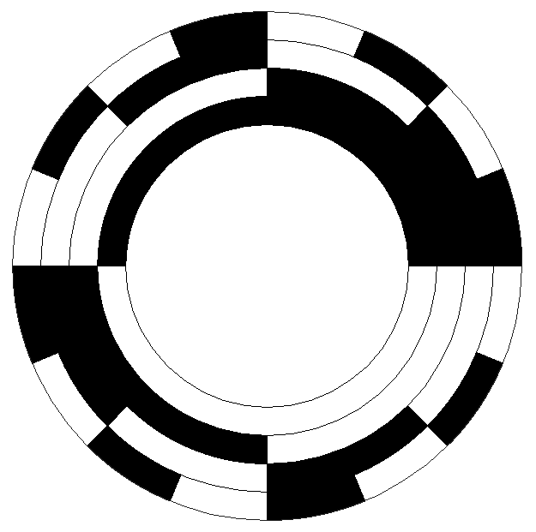
Robotic Sensors: Encoders
Encoders provide position information for a robot or machine such as a mill
As a robot or machine moves, the encoder disk produces a signal
Below are disks representing two encoder types
Absolute
Incremental

Slide 39
Robotic Sensors: Encoders
Absolute Encoder
A unique pattern on the disk is interpreted as a known location at each position
Count remains absolute despite potential power disconnections
Notes:
An absolute encoder has a unique value (voltage, binary count, etc.) for each mechanical position. When an absolute encoder is turned on, the position of an absolute encoder is known.

Slide 40
Robotic Sensors: Encoders
Incremental Encoder
A uniform pattern on the disk provides a signal about a change in position relative to its last known location
The position information is precise over the entire range of motion, yet the accuracy depends upon the last known position
A robot forgets its position after a power disruption
After a power disruption, a homing operation will move the robot or machine to limit switches to reestablish a known position
Notes:
An incremental encoder provides a series of periodic signals due to mechanical motion. The number of successive cycles (signals) corresponds to the resolvable mechanical increments of motion (measuring steps). Incremental encoders have output signals that repeat over the full range of motion. It is important to understand that each mechanical position is not uniquely defined.
When the incremental encoder is turned on, the position of an incremental encoder is not known since the output signals are not unique to any singular position. An incremental encoder often depends on a limit switch through a homing operation to determine its absolute position.

Slide 41
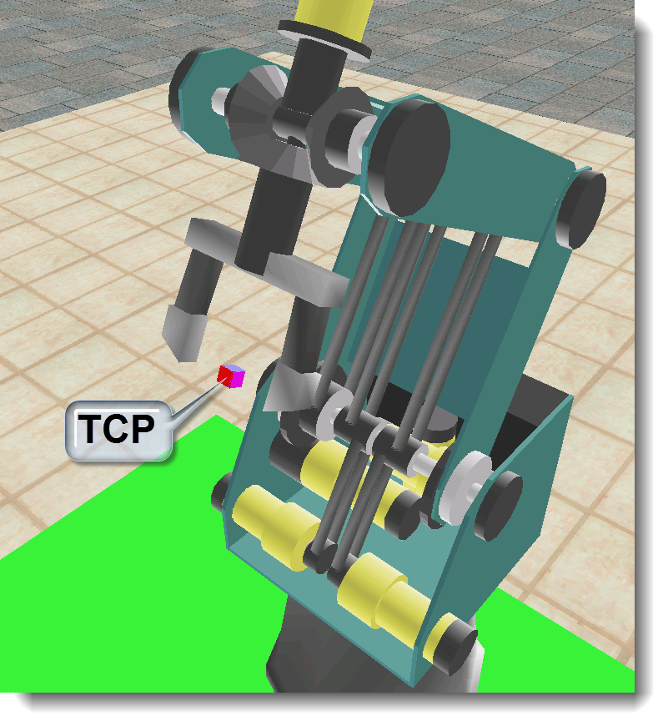
Robotic Sensors: Encoders
Most industrial robots use incremental or absolute encoders to determine where TCP is within its work envelope at all times
TCP is Tool Center Point - the X,Y,Z coordinate of the end effector
Notes:
Tool Center Point or TCP is very important, as this is where the work gets done. It may be the tip of a robotic welder or the point between the two grippers of a robot. You can describe it easily by turning on robot path in Robocell; the result trail left by the robot comes from TCP.

Slide 42
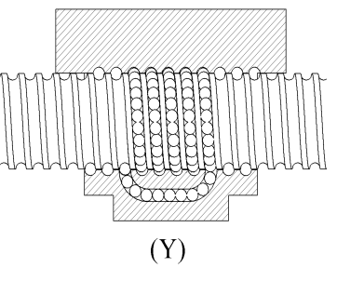
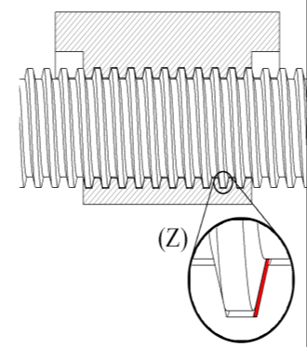
Lead Screw
Lead screw
Specialized to translate rotational to linear motion
Example is the table on a milling machine moving in the x and y
Ball Screw
Acme Screw
Notes:
Ball Screws
The above image shows the cross-section of a ball screw system used to move the table along the 3 axes in machining centers. Because the screw has rounded teeth, it allows a ball bearing to ride in the groove so that there is little or no backlash.
Acme Thread
The above image shows the cross-section of an acme screw system used to move the table along the 3 axes in machining centers. An acme screw is stronger than a regular screw thread because of the flat on the teeth. In all screw systems there must be some space between the teeth that allows the screw to move without binding (shown in red in the above diagram). Because of this space, backlash occurs, rendering the system less than 100% accurate.

Slide 43
Lead Screw: Ball Vs. Acme
Ball Screw
Rounded teeth with
ball bearings in a groove
Little or no backlash
Acme Screw
Flat teeth
Some backlash
Ball Screw
Acme Screw
Notes:
Ball Screws
The above image shows the cross-section of a ball screw system used to move the table along the 3 axes in machining centers. Because the screw has rounded teeth, it allows a ball bearing to ride in the groove so that there is little or no backlash.
Acme Thread
The above image shows the cross-section of an acme screw system used to move the table along the 3 axes in machining centers. An acme screw is stronger than a regular screw thread because of the flat on the teeth. In all screw systems there must be some space between the teeth that allows the screw to move without binding (shown in red in the above diagram). Because of this space, backlash occurs, rendering the system less than 100% accurate.

Slide 44
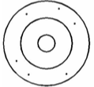
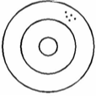
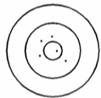
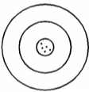
Accuracy vs. Precision or Repeatability
Accuracy is
Low
Precision or
Repeatability is
Low
Accuracy is
Low
Precision or
Repeatability is
High
Accuracy is
High
Precision or
Repeatability is
Low
Accuracy is
High
Precision or
Repeatability is
High
Notes:
There are two distinct terms that are related to uncertainty in measurement: accuracy and precision, which is also known as repeatability. Although accuracy precision and are often confused, there is a difference between the meanings of the two terms in the fields of science and engineering.
Accuracy indicates how close measurements are to the actual quantity being measured. For example, if you put a 50 pound weight on a bathroom scale, we would consider the scale to be accurate if it reported a weight of 50 pounds. A question that summarizes accuracy is can a robot hit the bull’s eye?
Precision (Repeatability) indicates how close together repeated measurements of the same quantity are to each other. A precise bathroom scale would give the same weight each time you stepped on the scale within a short time (even if it did not report your true weight). So, if you placed a 50 pound weight on the bathroom scale five times and the scale displayed a weight of 47 pounds each time, the scale could be considered precise (but not accurate). A question that summarizes repeatability is can a robot group the hits together consistently?

Slide 45
References
Black, T.J. &Kohser, R. (2008). Degarmo's materials and processes in manufacturing (10th ed.). Danvers, MA: John Wiley & Sons, Inc.
Keramas, J. (1999). Robot technology fundamentals. Retrieved from http://www.robotbasics.com/robot-drive-system

