Slide 1
FlowArm PLTW Programming
Introduction
Computer Integrated Manufacturing
© 2016 Project Lead The Way, Inc.

Slide 2
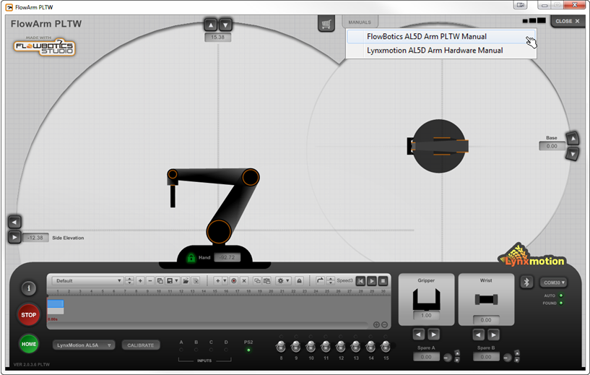
Help Available in Hardware and Software Manuals
Computer Integrated Manufacturing
© 2016 Project Lead The Way, Inc.
Notes:
The Lynxmotion hardware and software online manuals can be accessed directly from the FlowArm PLTW interface through the link shown.

Slide 3
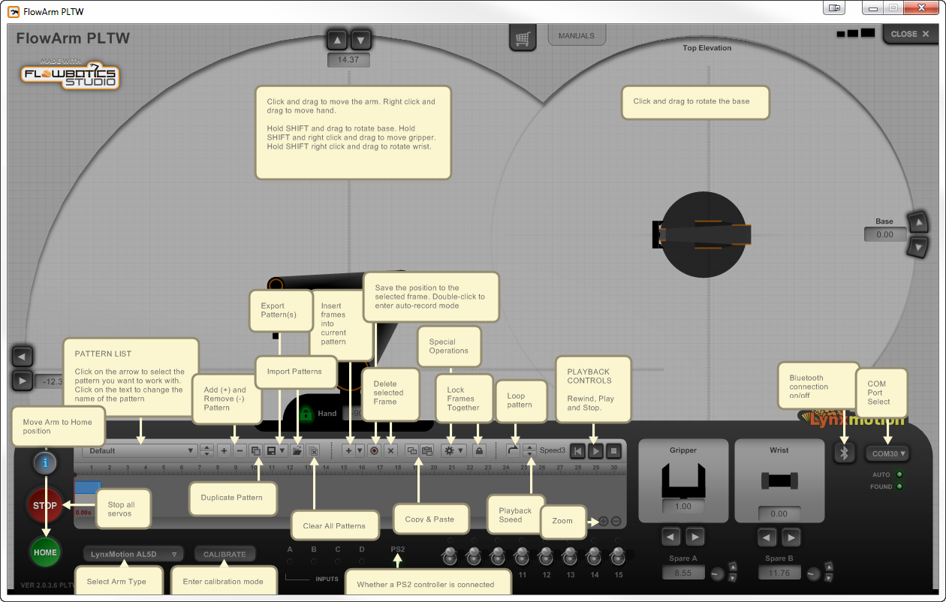
User Interface Information
Click to show icon information
Computer Integrated Manufacturing
© 2016 Project Lead The Way, Inc.

Slide 4
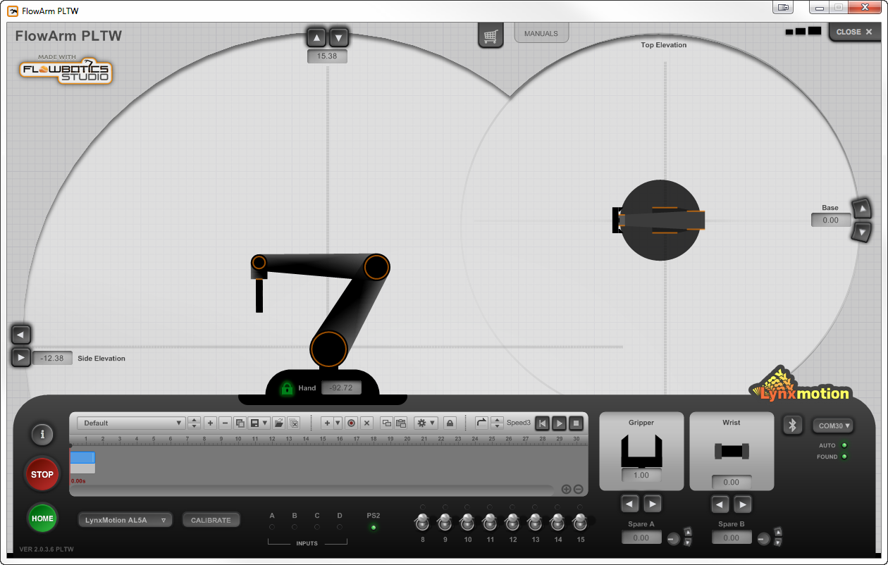
FlowArm PLTW Emergency Stop
Emergency Stop or E-Stop
stops all servo motion and communication.
Select again to resume operation.
Computer Integrated Manufacturing
© 2016 Project Lead The Way, Inc.

Slide 5
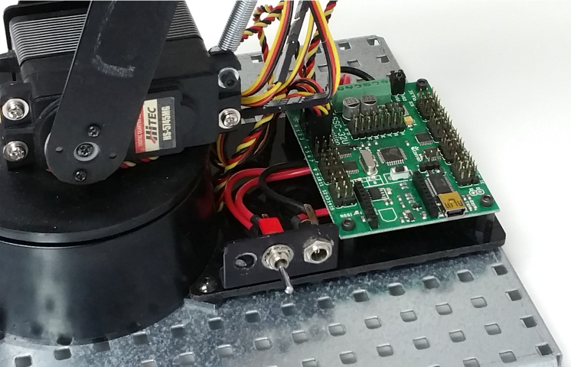
Robotic Arm Start Up Using a USB Cable and SSC-32U
Step 1. Connect the robot to a computer via USB cable. Wait for the Windows drivers to load. Note that this takes longer the first time.
Step 2. Connect the AC power adapter cable to the robot.
Step 3. Move the single switch to the on position.
Computer Integrated Manufacturing
© 2016 Project Lead The Way, Inc.

Slide 6
Robotic Arm Start Up Using a USB Cable and SSC-32U
Step 4. Open the FlowArm PLTW software.
Step 5. Select the Bluetooth Button.
Refer to Lesson 3.3 Lynxmotion Robotic Arm.
Computer Integrated Manufacturing
© 2016 Project Lead The Way, Inc.

Slide 7
FlowArm PLTW Sequencer
Sequence
Pattern consisting of multiple frames
Sequencer
Allows a pattern of robotic arm positions called frames to be recorded
Allows a pattern of frames to be played so a robotic arm repeats actions
Computer Integrated Manufacturing
© 2016 Project Lead The Way, Inc.

Slide 8
General Sequence Outline
Use these steps as a guide for moving objects.
Begin at a start position with gripper open.
Move the hand to a position directly above an object.
Move the hand to the object.
Close the gripper.
Lift the object up.
Move the object to a position above the drop-off position.
Set the object down where you want it.
Open the gripper.
Return to a position above the object.
Return to home position.
Computer Integrated Manufacturing
© 2016 Project Lead The Way, Inc.

Slide 9
Sequencer General Steps
Use these steps to develop a sequence.
Save the current sequence.
Position the robot in a “home” position.
Record the position.
Click the button to add a position.
Move the arm to desired position.
Record the position.
Repeat steps 4–6 to complete sequence.
Click individual steps to verify positions.
Rewind and play the entire sequence from the first step.
Save the current sequence.
Computer Integrated Manufacturing
© 2016 Project Lead The Way, Inc.

Slide 10
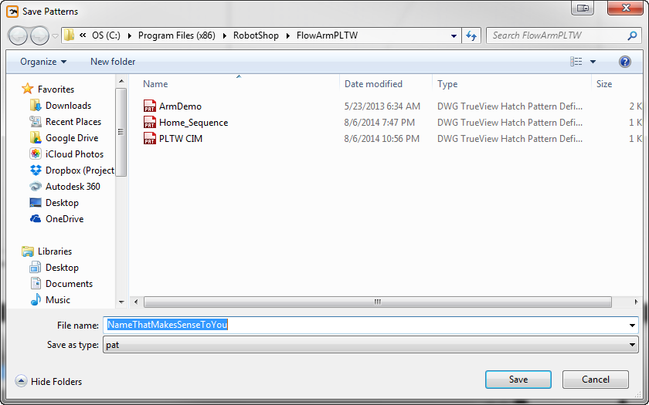
Sequencer General Steps
Step 1: Save the selected pattern.
Enter a meaningful file name and select Save.
Note that the words sequence and pattern are interchangeable.
WARNING!
Unless the pattern is saved, all changes will be lost when you close the FlowArm PLTW software
Computer Integrated Manufacturing
© 2016 Project Lead The Way, Inc.

Slide 11
Sequencer General Steps
Step 2: Move the robot to a start position using a preferred arm movement method.
Step 3: Record the current position in the selected frame.
The current position of every servo will be recorded.
Computer Integrated Manufacturing
© 2016 Project Lead The Way, Inc.

Slide 12
Sequencer General Steps
Step 4: Add a frame.
Note to remove a frame select it in the Sequencer and then select the Delete Frame button.
Step 5: Move the robot to a start position using a preferred arm movement method.
Computer Integrated Manufacturing
© 2016 Project Lead The Way, Inc.

Slide 13
Sequencer General Steps
Step 6: Record the current position in the selected frame.
Step 7: Repeat steps 4–6 until the pattern is completed.
Step 8: Click on each frame to verify the correct position.
Adjust the time duration of each frame by dragging the end of the frame.
WARNING!
A step duration must allow an arm to physically complete the step. If the duration is too short, then the step might be skipped or the arm does not reach the correct target.
Computer Integrated Manufacturing
© 2016 Project Lead The Way, Inc.

Slide 14
Sequencer General Steps
Step 9: Rewind the pattern to the beginning and play the sequence.
Make necessary changes to the sequence.
Stop; vary playback speed or loop
Recording.
Step 10: Save the current sequence.
WARNING!
Unless you save the pattern all changes will be lost when you close FlowArm PLTW software
Computer Integrated Manufacturing
© 2016 Project Lead The Way, Inc.

Slide 15
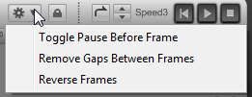
Sequencer Tips
Sequence options: pause, remove gaps, and reverse.
Add a new pattern and name each new pattern to record several within a file.
The image below shows the correct plus sign symbol location to add a new pattern.
Computer Integrated Manufacturing
© 2016 Project Lead The Way, Inc.

Slide 16
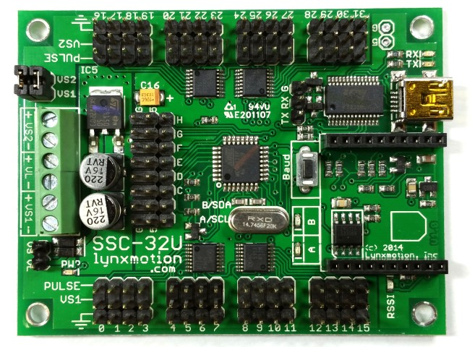
Inputs
You can use inputs A–D to control a start and stop to a saved sequence.
Inputs A–D are connected to the input pins shown on the Lynxmotion SSC-32U board.
If no actual inputs are sensed or connected to the robot, you can select them in the FlowArm PLTW Software.
Computer Integrated Manufacturing
© 2016 Project Lead The Way, Inc.
Notes:
Note that pin A and B do not have a label.

Slide 17
Inputs
Input A – Digital start sequence from beginning
Input B – Return from digital pause
Input C – Return from digital pause
Input D – Stop sequence in progress (e.g., emergency stop)
Computer Integrated Manufacturing
© 2016 Project Lead The Way, Inc.

Slide 18
Inputs B and C
A pause in a step will halt the sequence at the beginning of a step.
Inputs B and C can be used to return motion to a sequence at a digital pause.
To add a digital pause to a step, use the procedure below.
Remove a pause using the same procedure.
1. Step Before
2. Toggle Pause
3. Step After
Computer Integrated Manufacturing
© 2016 Project Lead The Way, Inc.

Slide 19
Inputs A and D
A signal from input A starts a sequence from the beginning or stops a sequence in progress, rewinds the sequence to home, and restarts the sequence.
A signal from input D will stop a sequence and is a good option for an emergency stop.
Computer Integrated Manufacturing
© 2016 Project Lead The Way, Inc.

Slide 20
Input Response Summary
 | Sequence Status
Input | At Beginning | Stopped During | Stopped at End | At Digital Pause | In Progress
A | Starts from Beginning | Returns and Starts from Beginning | Returns and Starts from Beginning | Returns and Starts from Beginning | Stops and Restarts from Beginning
B | Starts from Beginning | Restarts from Current Time | Nothing | Resumes from Current Pause | Nothing
C | Starts from Beginning | Restarts from Current Time | Nothing | Resumes from Current Pause | Nothing
D | Nothing | Nothing | Nothing | Nothing | Stops at Current Time
Computer Integrated Manufacturing
© 2016 Project Lead The Way, Inc.

Slide 21
Reference
AL5 arm guide. (2014). Retrieved January 1, 2016, from http://www.flowbotics.com/manuals/flowarm-pltw.pdf
Computer Integrated Manufacturing
© 2016 Project Lead The Way, Inc.

