Slide 1
4.0.1 - Architectural Elevations
William Hough High School
Cornelius, NC

Slide 2
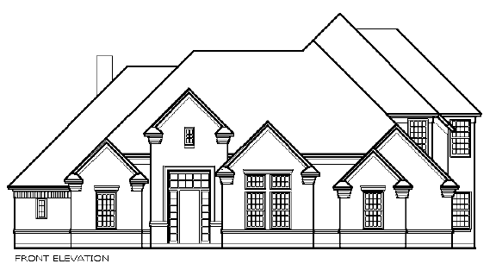
Architectural Elevations
Two Dimensional views of a house that show the following:
Shape of the building
Exterior Veneer materials
Roof Type
Roof Pitch
Exterior Trim Details
Architectural Style
Window Size, Type, Location & height above floor.
Door Size, Type & Location.

Slide 3
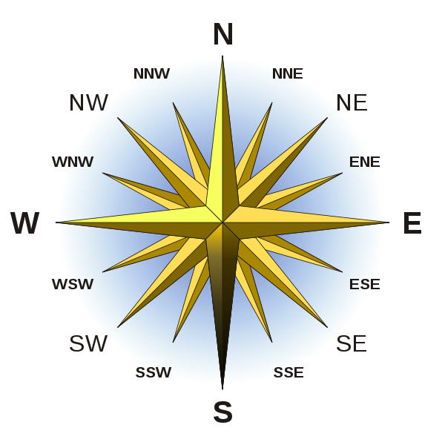
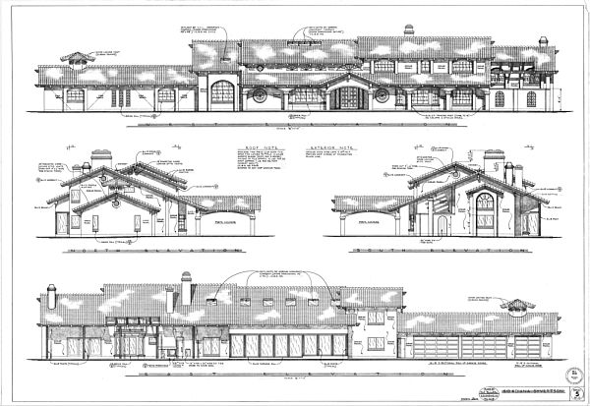
Architectural Elevations
South Elevation - Front
North Elevation – Rear
East Elevation – Right Side Elevation
West Elevation - Left Side Elevation

Slide 4
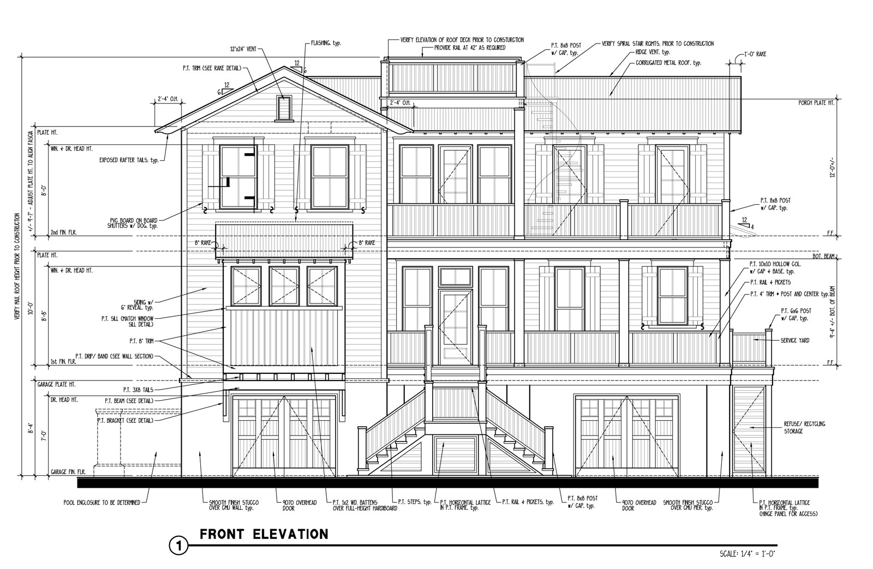
Architectural Elevations
Shutters
Porch Rails
Elevation Details-Examples:
Vents
Height from Floor to Ceiling
Height from Floor to Window Head
Grade Level

Slide 5
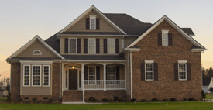
Architectural Elevations
Detail Examples (Continued):
Roofing Materials
Roof Pitch
Window
Size/Type & Location
Exterior Veneer Materials
Porch
Rails and Columns

Slide 6
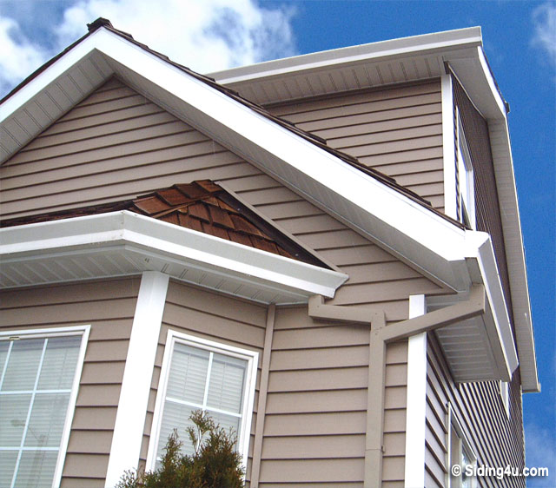
Architectural Elevations
Architectural
Elevation Features:
Veneer Material
Fascia
Corner Trim
Fascia
Gutters
Fascia - Board used to cover the ends of the Rafter Tails

Slide 7
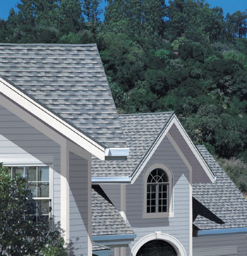
Architectural Elevations
Common Parts of Architectural Elevations:
Shingles
Elevations illustrate the roofing materials to be used on the house.

Slide 8
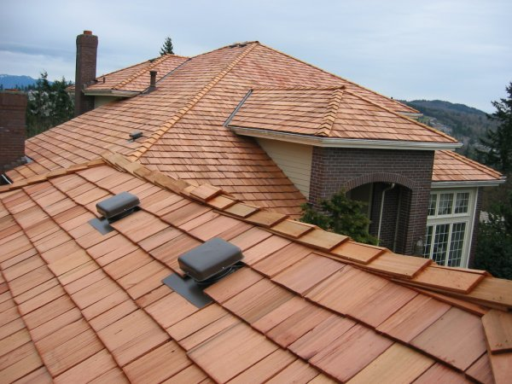
Architectural Elevations
Common Parts of Architectural Elevations:
Cedar Shakes
Elevations illustrate the roofing materials to be used on the house.

Slide 9
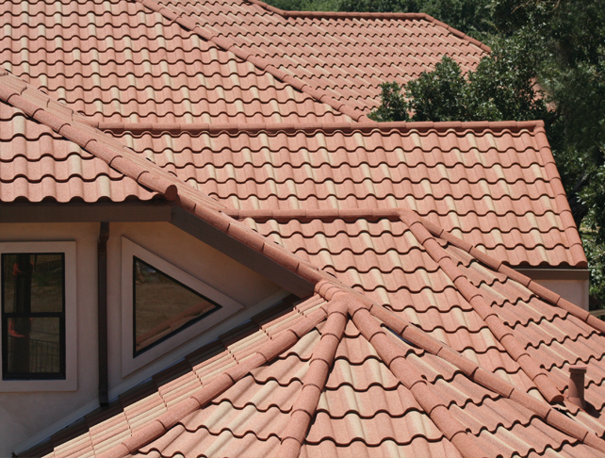
Architectural Elevations
Common Parts of Architectural Elevations:
Ceramic Roof Tiles
Elevations illustrate the roofing materials to be used on the house.

Slide 10
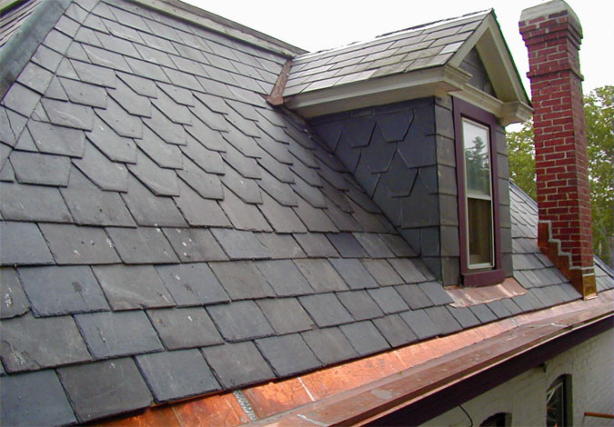
Architectural Elevations
Common Parts of Architectural Elevations:
Slate Roof Tiles & Siding
Elevations illustrate the roofing materials to be used on the house.
Copper Gutters & Flashing

Slide 11
End of Unit 4.0.1
William Hough High School
Cornelius, NC

