Slide 1
CIM Systems
Computer Integrated Manufacturing
© 2013 Project Lead The Way, Inc.

Slide 2
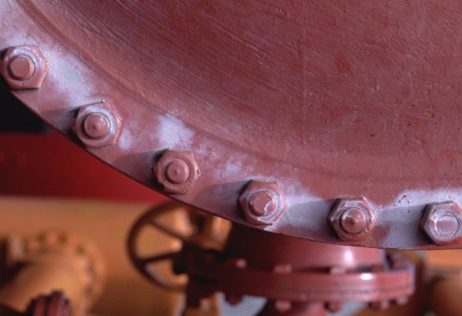
System Types
Mass Production
Workcell
FMS
Notes:
The three common types of CIM systems are mass (specialized) production, workcell, and FMS.
No matter the system, a process design chart is necessary to plan production. Process design will be discussed later.

Slide 3
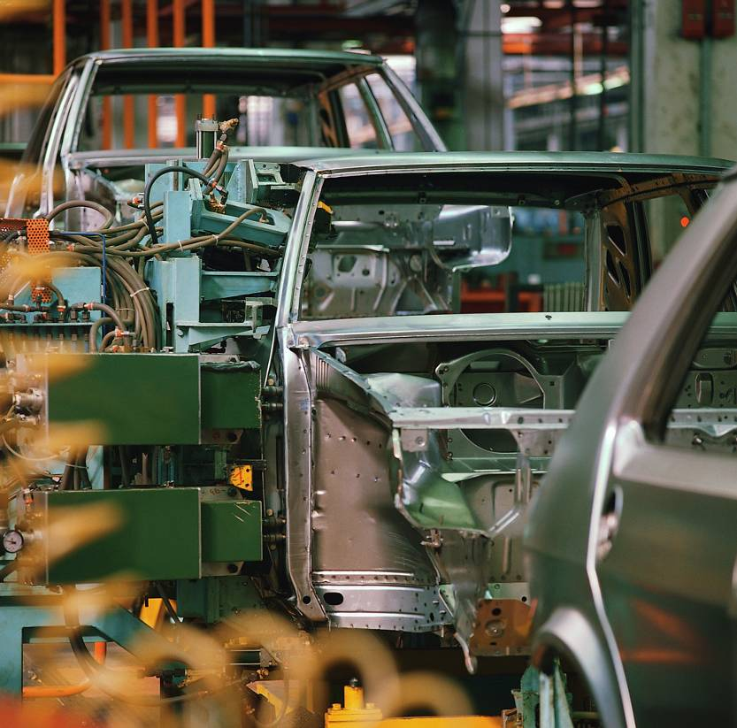
Mass Production
Least flexible
Example – auto assembly plant
Fast model changeover necessary for high production rates
Notes:
Mass production is a process that can include specialized and single-purpose machines to produce many identical parts. Considering the physical size and complexity of an automobile, it is hard to imagine building Buicks one day and toasters another. For the automobile industry, this does not represent a problem. Most car and truck plants in the United States are designed to run at close to 100% capacity; there is no incentive to make the plant more flexible.

Slide 4
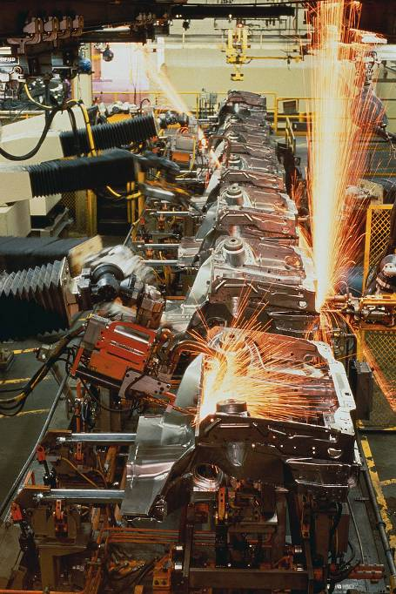
Workcell
Grouping of machines in close proximity
Robot or human operator moves pieces from machine to machine
Machines are easily retooled to accommodate a new item
Workcell groupings are cost-effective
Notes:
Each machine has its own specialty.

Slide 5
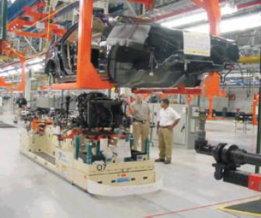
Flexible Manufacturing System
Machine line supplied by Automatically Guided Vehicles (AGVs)
Machine line can handle an entire family of parts
Notes:
Computers are used to download information to indicate which parts are being made at any one time.

Slide 6
FMS Components
Automatic identification system
Computer work directors
Multi-functional tools
Automated material handling
Robotics
Notes:
Automatic Identification System – Data collection
Computer Work Directors – Computers point parts in the right direction
Multi-Functional Tools – Includes quick-change tooling, fixturing, and assembly machines controlled by computers
Automated Material Handling – Can be ASRS or AGVs
Robotics – Executes computer commands and part distribution

Slide 7
FMS
FMS systems represent a large investment in machines, plant space, and software.
FMS systems assume that sufficient work will exist to keep the system busy.
FMS systems represent a tiny fraction of systems when compared to Specialized CIM and Workcell CIM systems.
Notes:
A stand-alone system is a multi-pallet system that can work on several types of parts at the same time but is independent of other systems. Such a system can be integrated into an FMS.

Slide 8
Planning
May use a Process Design Chart (graphic representation of events occurring in production)
Includes
Transport
Storage
Outsourcing
Quality testing
Can be illustrated with flow charts
Notes:
A process chart will also include instructions for operators, machine tools, inspection, and time standards.

Slide 9
Image Resources
Microsoft, Inc. (2008). Clip art. Retrieved from http://office.microsoft.com/en-us/clipart/default.aspx

