Slide 1

Principles and Elements of Design Applied to Architecture
Civil Engineering and Architecture
© 2010 Project Lead The Way, Inc.

Slide 2
Visual Design Elements
Six integral components used in the creation of a design:
Line
Color
Form and Shape
Space
Texture
Value
Notes:
You can make the analogy that the elements are like baking/cooking ingredients.

Slide 3
Line
Types
  Vertical – Represents dignity, formality, stability, and strength
  Horizontal – Represents calm, peace, and relaxation
  Diagonal – Represents action, activity, excitement, and movement
  Curved – Represents freedom, the natural, having the appearance of softness, and creates a soothing feeling or mood

Slide 4
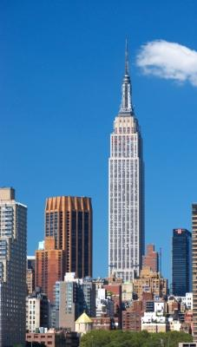
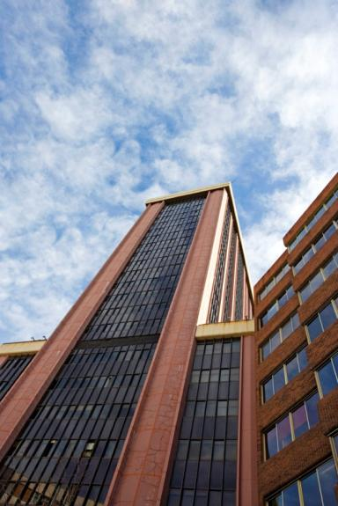
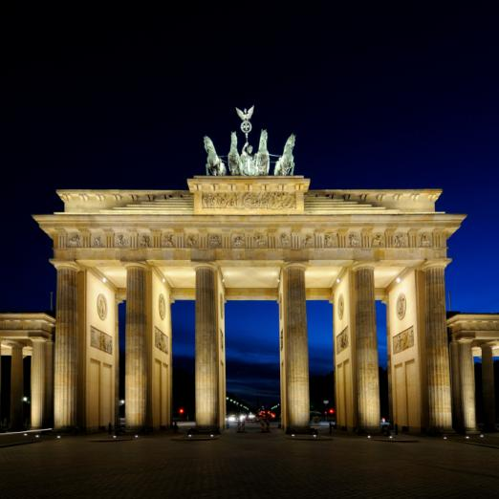
Vertical Lines
Skyscraper
Madrid, Spain
Microsoft Office clipart
The Empire State Building
Architect: Shreve, Lamb, and Harmon
Brandenburg Gate
Berlin
Notes:
The Empire State Building in New York City, an international landmark, is an excellent example of the architectural style know as Art Deco. It was designed by the architectural firm of Shreve, Lamb, and Harmon. William Lamb was the chief designer.
The vertical characteristics represent dignity, formality, stability, and strength.

Slide 5
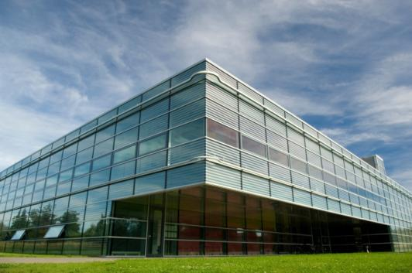
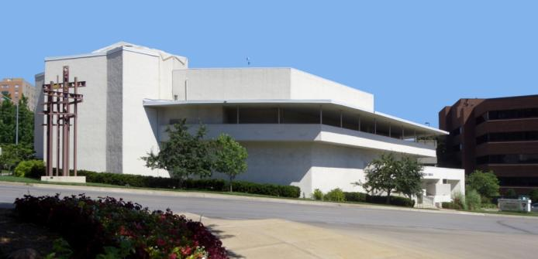
Horizontal Lines
Microsoft Office clipart
Wikimedia.org
Community Christian Church
Kansas City, MO
Architect: Frank Lloyd Wright, 1940
Notes:
Horizontal lines represent calm, peace, and relaxation. Frank Lloyd Wright was well know for using horizontal lines in many of his designs.

Slide 6
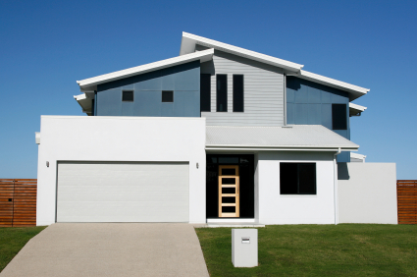
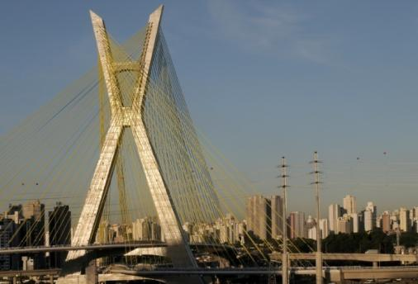
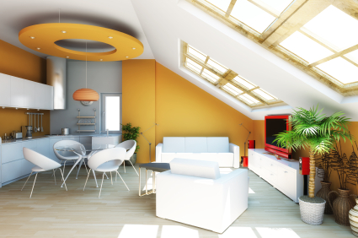
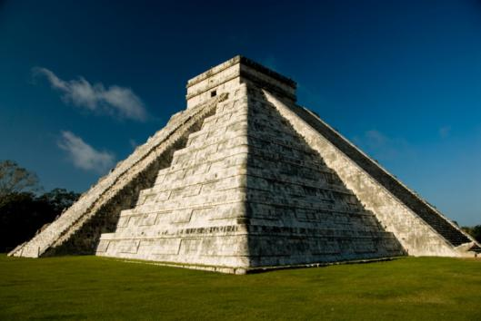
Diagonal Lines
Microsoft Office clipart
©iStockphoto.com
©iStockphoto.com
Microsoft Office clipart
Notes:
Diagonal lines give the sense of movement, action, and activity.
The upper right image shows the Octavio Frias de Oliverira Bridge in Sao Paulo, Brazil. This is a cable-stayed suspension bridge which opened in May 2008. It is the only bridge in the world that has two curved approaches supported by a single concrete mast.

Slide 7
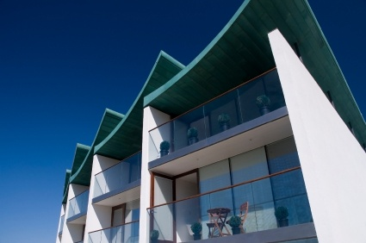
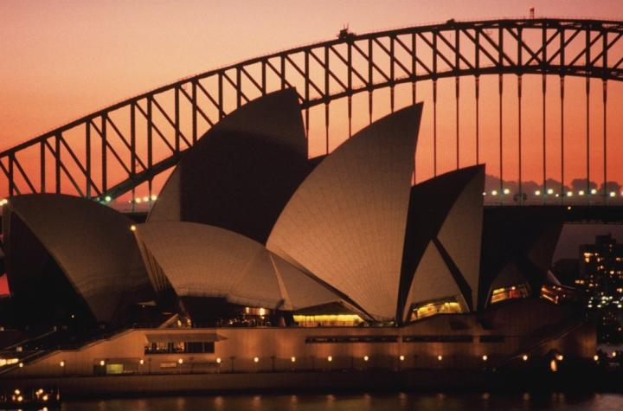
Curved Lines
Microsoft Office clipart
©iStockphoto.com
Sydney Opera House
Jorn Utzon
Notes:
Flowing, curved lines are used in the roof of this apartment building, the roof structure of the Sydney Opera House, and the Sydney Harbor Bridge in the background. Curved lines often appear more natural than angular lines and give the sense of freedom and soothing mood.
The Sydney Opera House is a world-famous work of architecture. The Danish architect Jorn Utzon won an international competition to design the structure. After extensive testing, Utzon decided to use a design based on sections of a sphere.

Slide 8
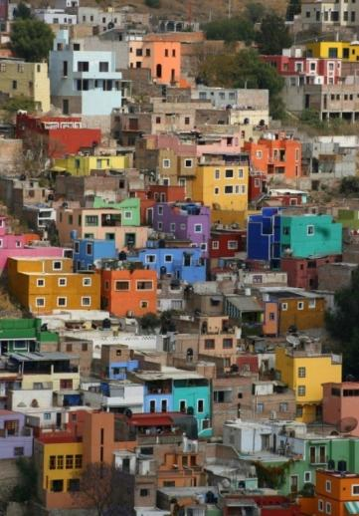
Color
Color has an immediate and profound effect on a design.
©iStockphoto.com
Microsoft Office clipart
Saint Basil’s Cathedral
Moscow
Microsoft Office clipart
Notes:
Saint Basil’s Cathedral was designed in the shape of the flame of a bonfire rising into the sky. Bright colors create a festive feeling and sense of excitement.

Slide 9
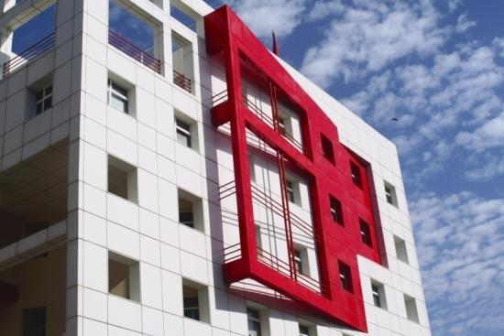
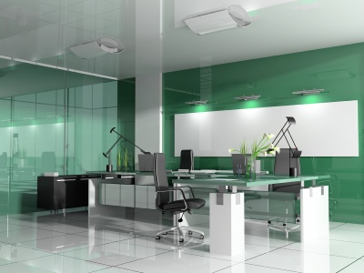
Color
©iStockphoto.com
Warm Colors
  Reds, oranges, yellows
Cool Colors
  Blues, purples, greens
©iStockphoto.com
Notes:
How would the building in the top picture look without the red accent?
Do the green colors in the bottom picture energize you or make you feel calm and cool?

Slide 10
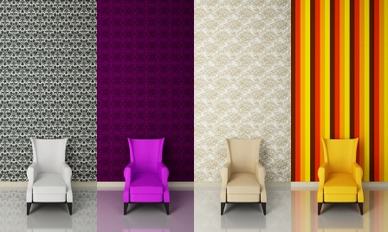
Color
©iStockphoto.com
  Colors can affect how humans feel and act
Notes:
Which color scheme creates the most excitement? Why? Which color scheme feel the most opulent? Which color scheme would you choose for a playroom? Living room? Bedroom?

Slide 11
Form and Shape
Form: (3D)The shape and structure of something as distinguished from its substance or material.
Shape: (2D)The two-dimensional contour that characterizes an object or area.
Notes:
Form can also be described as the composition of geometric shapes. Shape can be described as the contour, profile, or silhouette.

Slide 12
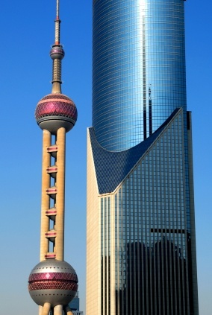
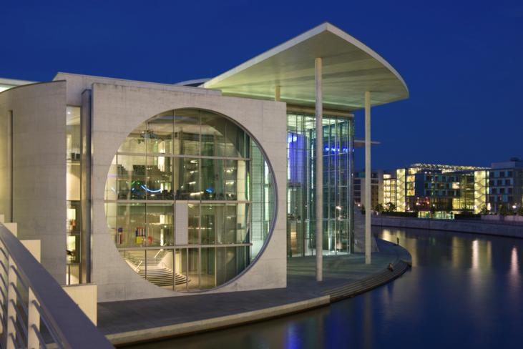
Form and Shape
©iStockphoto.com
Microsoft Office clipart
Marie-Elisabeth-Lüders-Haus
Berlin, Germany
Oriental Pearl Tower Shanghai
Architect: Jiang Huan Cheng, Shanghai Modern Architectural Design, Co.
Notes:
The Oriental Tower is a television tower in Shanghai and includes fifteen observatory levels and a revolving restaurant. Its design includes 11 spheres, large and small. The two largest spheres (shown) have diameters of 164 ft (the lower sphere) and 148 ft (the upper sphere). The design is based on the Tang Dynasty poem Pipa Song by Bai Juyi about the wonderful sprinkling sound produced by a pipa instrument, like pearls, big and small, falling on a jade plate.

Slide 13
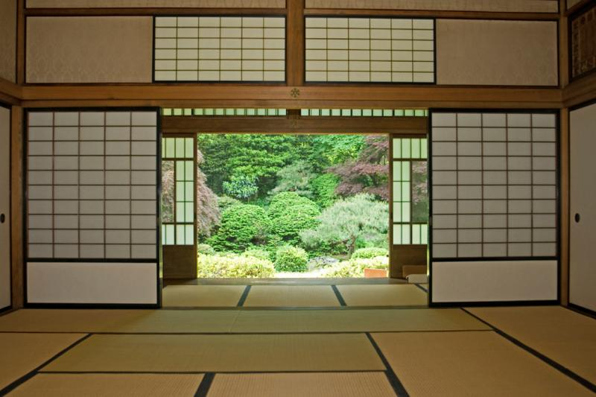
Space
By incorporating the use of space
in your design, you can enlarge or reduce the visual space.
Microsoft Office clipart
Types
  Open, uncluttered spaces
  Cramped, busy spaces
  Unused vs. good use of space
Microsoft Office clipart
©iStockphoto.com
Microsoft Office clipart
Notes:
[click] Open space
[click] Busy, well used space

Slide 14
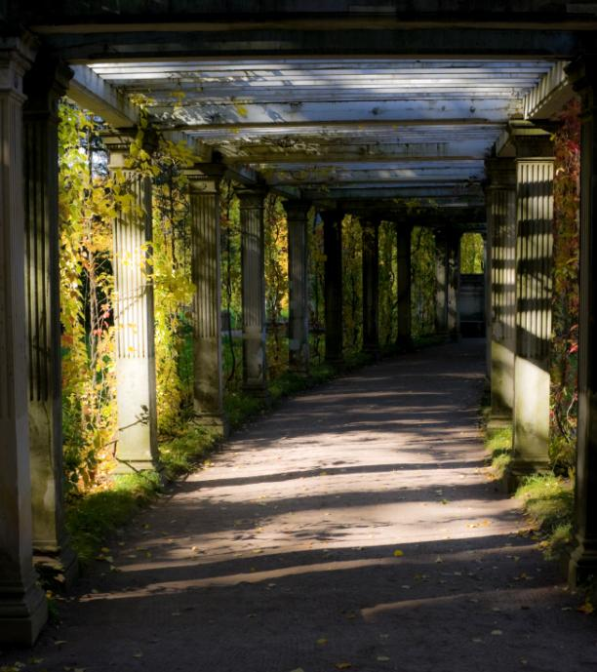
Space
By incorporating the use of space
in your design, you can enlarge or reduce the visual space.
Microsoft Office clipart
Types
  Open, uncluttered spaces
  Cramped, busy spaces
  Unused vs. good use of space
Microsoft Office clipart
©iStockphoto.com
Microsoft Office clipart
Notes:
[click] Open space
[click] Busy, well used space

Slide 15
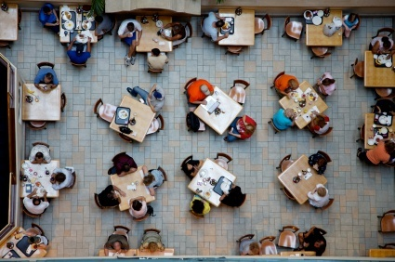
Space
By incorporating the use of space
in your design, you can enlarge or reduce the visual space.
Types
  Open, uncluttered spaces
  Cramped, busy spaces
  Unused vs. good use of space
©iStockphoto.com
Notes:
[click] Open space
[click] Busy, well used space

Slide 16
Texture
The surface look or feel of something
Smooth Surface – Reflects more light and therefore is a more intense color.
Rough Surface – Absorbs more light and therefore appears darker.

Slide 17
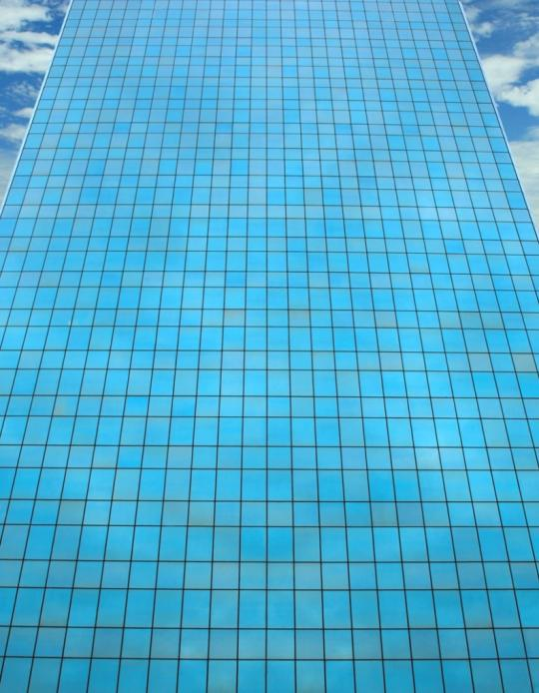
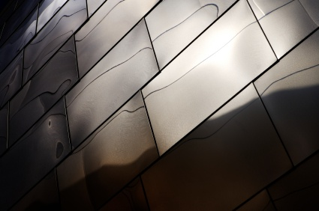
Smooth Texture
©iStockphoto.com
Microsoft Office clipart
Glass façade of a high rise office building
Exterior metal façade of Disney Concert Hall
Los Angeles

Slide 18
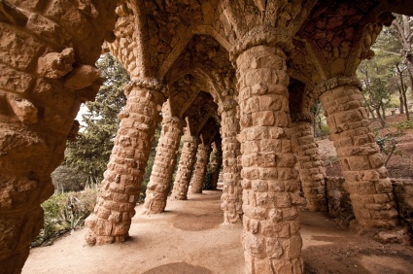
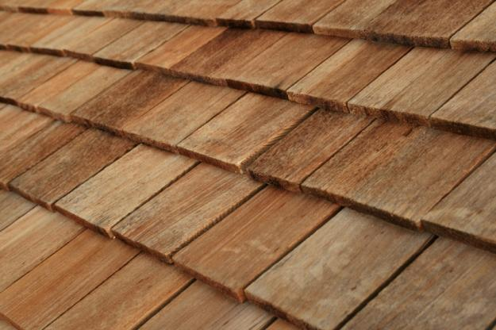
Rough Texture
©iStockphoto.com
Park Guell – Barcelona, Spain Architect: Antonio Gaudí
©iStockphoto.com
Notes:
Park Gruell is a famous park and sculpture garden in Barcelona, Spain designed by Antonio Gaudi in the expressionist style. It was originally designed as a housing development but was commercially unsuccessful and was later turned into a park.

Slide 19
Value
The relative lightness or darkness of a color
Methods
  Shade – Degree of darkness of a color
  Tint – A pale or faint variation of a color
Notes:
Add black to obtain a shade. Add white to obtain a tint.

Slide 20
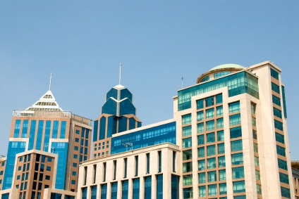
Value
©iStockphoto.com
Downtown buildings in Bangalore, India
Notes:
The different buildings use varying values of blue/green.

Slide 21
Visual Design Principles
Seven principles encompass an interesting design.
Balance
Rhythm
Emphasis
Proportion and scale
Movement
Contrast
Unity
Notes:
Different lists of design principles are used by various occupational areas. You can make the analogy that the principles of design are similar to how you combine and utilize baking ingredients. Do you blend, whip or fold, do you fry, bake or broil, slow roast, or microwave? How much flour, salt, spice, or baking powder do you use?

Slide 22
Balance
Parts of the design are equally distributed to create a sense of stability. Both physical and visual balance exist.
Types
  Symmetrical or formal balance
  Asymmetrical or informal balance
  Radial balance
  Vertical balance
  Horizontal balance

Slide 23
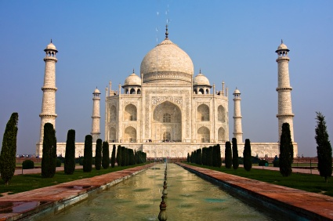
The elements within the design are identical in relation to a centerline or axis.
Balance
Symmetrical or Formal Balance
©iStockphoto.com
The Taj Mahal Mausoleum
Agra, Uttar Pradesh, India
Notes:
Taj Mahal Mausoleum was designed as a tomb by Emperor Shah Jahan for his young wife Mumatz Mahal. With the onion domes, it is a famous example of Islamic architecture.

Slide 24
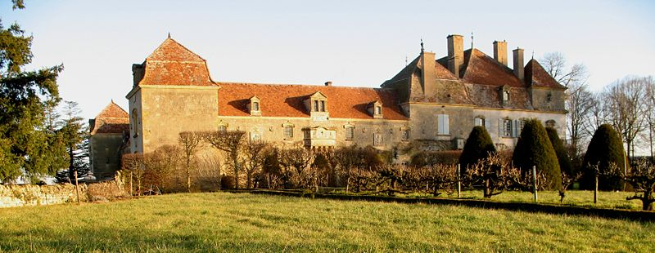
Balance
Asymmetrical or Informal Balance
Parts of the design are not identical but are equal in visual weight.
Wikipedia.org
Chateau de Chaumont
Saone-et-Loire, France
Notes:
This building is asymmetrical, but because it is located quite a distance from the main section, the large boxy section far left balances the main section of the chateau.

Slide 25
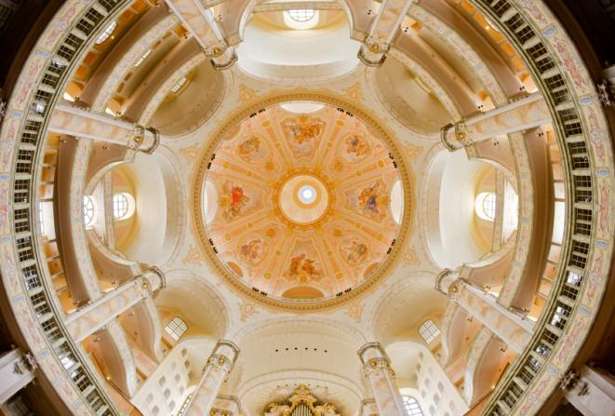
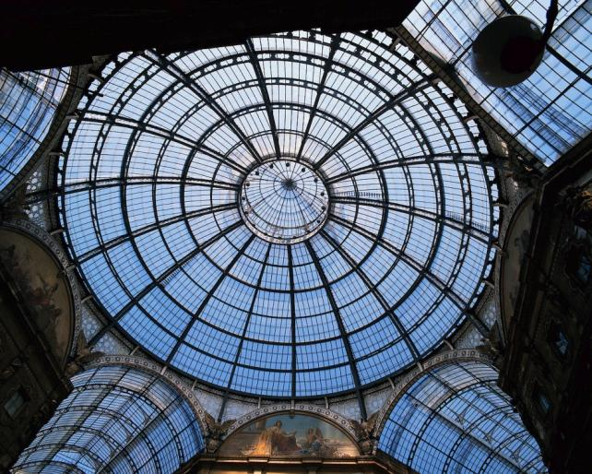
Balance
Radial Balance
Design elements radiate outward from the center.
Microsoft Office clipart
Microsoft Office clipart
Dresden Frauenkirche
Deresden, Germay
Galleria Vittorio Emanuele II
Milan, Italy
Architect: Giuseppe Mengoni
Notes:
The Galleria Vittorio Emanuele II dome encloses an octagonal space formed at the intersection of two intersecting streets. Designed in 1861 and built between 1865 and 1877, it is an early formal covered street.

Slide 26
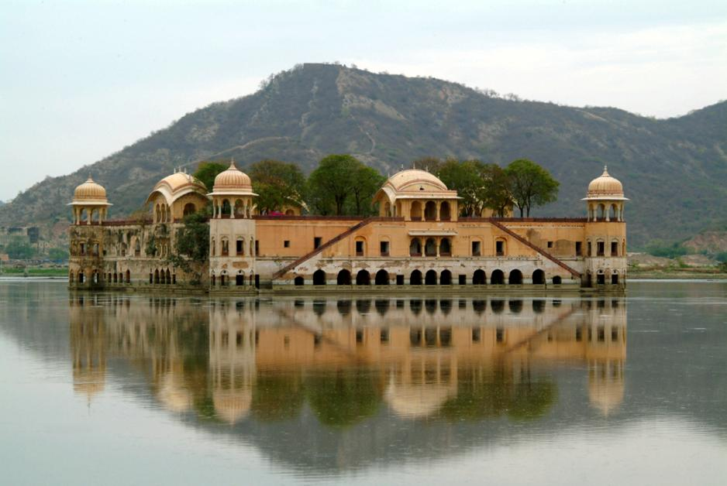
Balance
Vertical Balance
The top and bottom parts are equal.
Microsoft Office clipart
Notes:
A vertical balance is achieved by the reflection of the building in the water

Slide 27
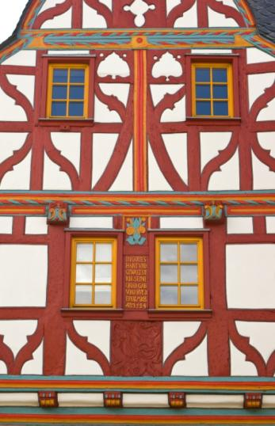
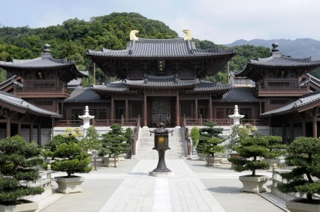
Balance
Horizontal Balance
The parts on the left and right sides are equal.
Microsoft Office clipart
©iStockphoto.com
Chi Lin Buddhist Temple and Nunnery
Kowloon City, Hong Kong
Building façade
Limberg, Germany
Notes:
Both the Chinese design and the half timbered structure illustrate horizontal balance. If a vertical line were drawn down the center of each design, the left and right would be mirror images.
[click] A famous female architect, Julia Morgan, who was trained as a civil engineer, designed the Hearst estate in California (a National Historic Landmark). William Randolph Hearst at first wanted to build a bungalow so that he would not have to camp in tents on the site. His original idea quickly expanded to include a palatial estate with several outbuildings. The Hearst Castle includes 56 bedrooms, 61 bathrooms, 10 sitting rooms, indoor and outdoor pools, and the largest private zoo in the world. The building shown here is Casa Grande, the main residence.

Slide 28
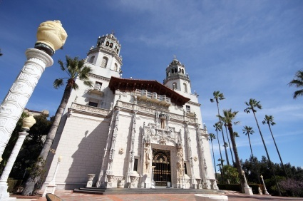
Balance
Horizontal Balance
The parts on the left and right sides are equal.
©istockphoto.com
Hearst Castle
San Simeon, CA
Architect: Julia Morgan
Notes:
Both the Chinese design and the half timbered structure illustrate horizontal balance. If a vertical line were drawn down the center of each design, the left and right would be mirror images.
[click] A famous female architect, Julia Morgan, who was trained as a civil engineer, designed the Hearst estate in California (a National Historic Landmark). William Randolph Hearst at first wanted to build a bungalow so that he would not have to camp in tents on the site. His original idea quickly expanded to include a palatial estate with several outbuildings. The Hearst Castle includes 56 bedrooms, 61 bathrooms, 10 sitting rooms, indoor and outdoor pools, and the largest private zoo in the world. The building shown here is Casa Grande, the main residence.

Slide 29
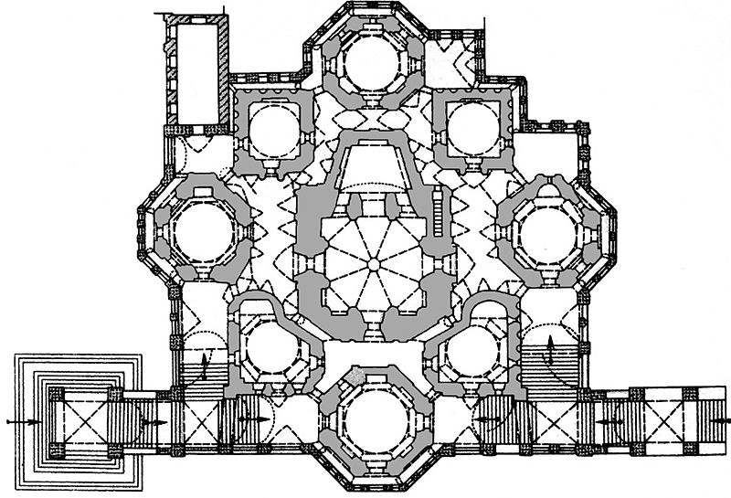
Balance
Wikipendia.org
Notes:
This is the first floor plan of Saint Basil’s Cathedral. If you ignore the three entrances, the floor plan displays radial balance. Notice that the it also displays horizontal and vertical balance.

Slide 30
Rhythm
Repeated use of line, shape, color, texture or pattern
Types
  Regular rhythm
  Graduated rhythm
  Random rhythm
  Gradated rhythm
Notes:
This principle is sometimes referred to as repetition.

Slide 31
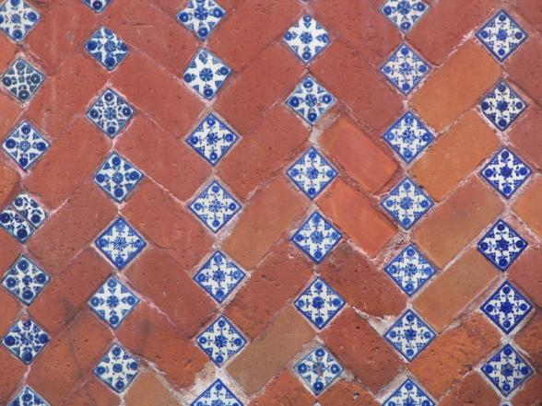
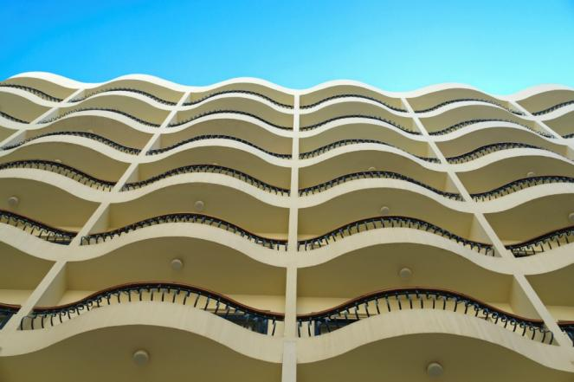
Rhythm
Regular Rhythm
An element is repeated at the same repetition/interval each time.
Microsoft Office clipart
Microsoft Office clipart
Notes:
A regular rhythm is created in the floor shown on the left by repeating the same pattern of bricks and tiles.
The undulating hotel balconies shown on the right are repeated at each level, creating a regular rhythm.

Slide 32
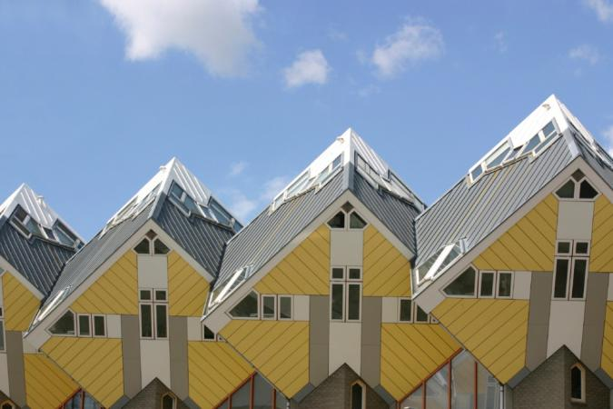
Rhythm
Regular Rhythm
An element is repeated at the same repetition/interval each time.
Microsoft Office clipart
Microsoft Office clipart
Cube house design
Rotterdam, Netherlands
Notes:
A regular rhythm is created in the floor shown on the left by repeating the same pattern of bricks and tiles.
The undulating hotel balconies shown on the right are repeated at each level, creating a regular rhythm.

Slide 33
Rhythm
Random Rhythm
The beats of the element are random or are at irregular intervals.
Notes:
The repeated use of the onion domes creates a random rhythm in the design of Saint Basil’s Cathedral.

Slide 34
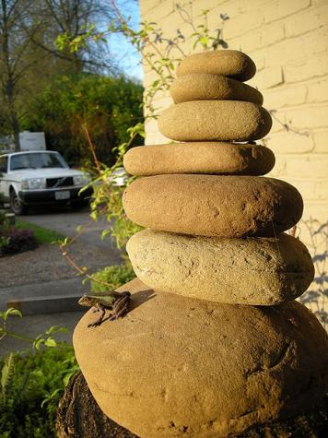
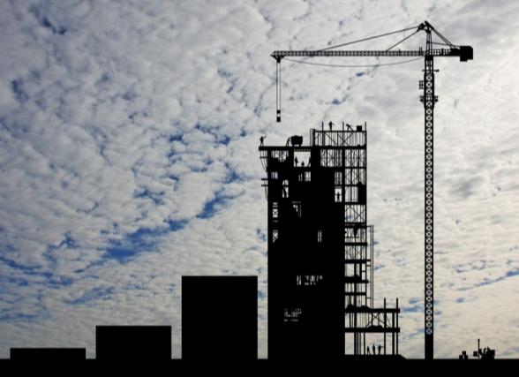
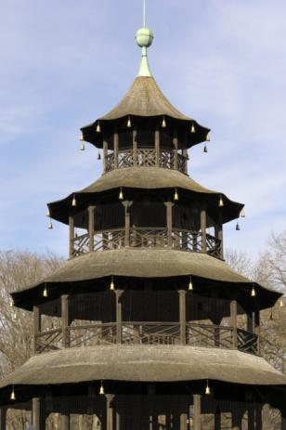
Rhythm
Gradated Rhythm
The repeated element is identical with the exception of one detail increasing or decreasing gradually with each repetition.
Microsoft Office clipart
Left: Stack of rocks used as focal point in landscaping
Right: The Chinese Tower English Gardens
Munich, Germany
www.wikimedia.org
Microsoft Office clipart

Slide 35
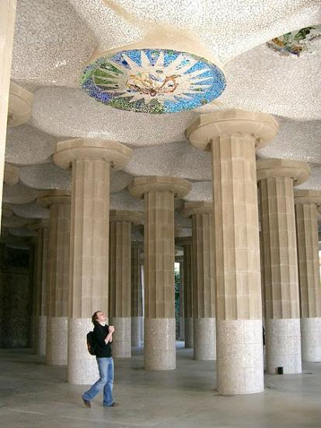
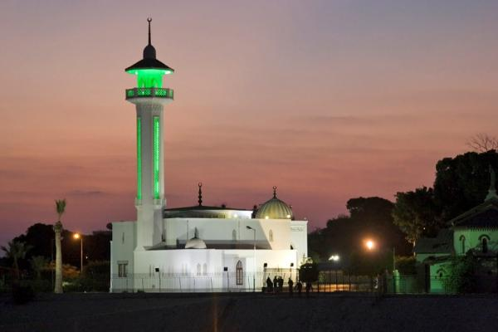
Emphasis
Wikipedia.org
The feature in a design that attracts one’s eye – the focal point
Emphasis can be achieved through size, placement, shape, color, and/or use of lines
Ceiling mosaic in Park Gruell
Microsoft Office clipart
Microsoft Office clipart
Mosque - Egypt
Notes:
What draws your attention in the image? Why? Is it size, placement, color, or use of another element?
Although the mosaic is on the ceiling in the top image, because of the bright colors (which contrast with the neutral colors of the surrounding structure), the mosaic is the focal point.
The tower of the mosque is emphasized due to colored light, its height (much taller than surrounding structure) and its shape (round form contrasts with angular edges of the rest of the building)
[click] This is a picture of the Bahai Gardens in Haifa, Israel. The domed building in the distance is emphasized here – Why?
Location – The building is centered horizontally.
Lines – All lines lead to the building including the horizon line, the stairway, and lines of trees.
Shape – The building is a geometric shape which contrasts with the surrounding organic (natural) shapes and therefore stands out.

Slide 36
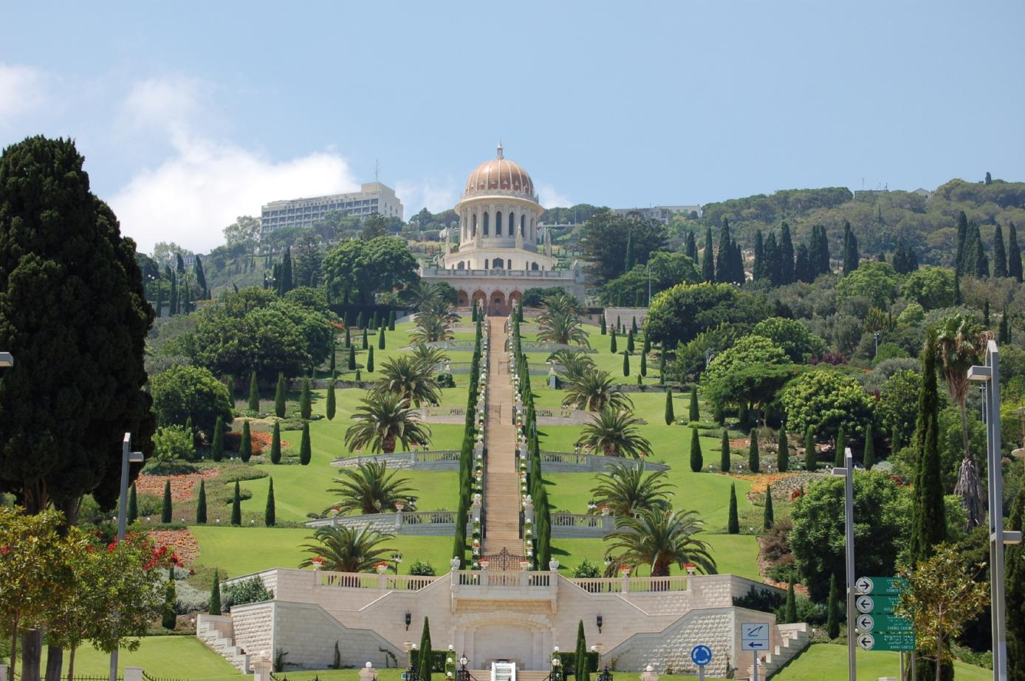
Emphasis
Wikipedia.org
Microsoft Office clipart
Notes:
What draws your attention in the image? Why? Is it size, placement, color, or use of another element?
Although the mosaic is on the ceiling in the top image, because of the bright colors (which contrast with the neutral colors of the surrounding structure), the mosaic is the focal point.
The tower of the mosque is emphasized due to colored light, its height (much taller than surrounding structure) and its shape (round form contrasts with angular edges of the rest of the building)
[click] This is a picture of the Bahai Gardens in Haifa, Israel. The domed building in the distance is emphasized here – Why?
Location – The building is centered horizontally.
Lines – All lines lead to the building including the horizon line, the stairway, and lines of trees.
Shape – The building is a geometric shape which contrasts with the surrounding organic (natural) shapes and therefore stands out.

Slide 37
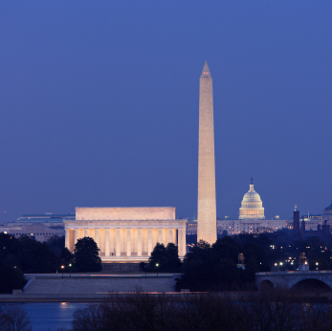
Proportion and Scale
Microsoft Office clipart
Comparative relationships between elements in a design with respect to size
3:5 ratio is known as the Golden Mean
Notes:
Because of its height, the Washington Monument is the most prominent structure in Washington, D.C., shown here with the Lincoln Memorial in the foreground and the U. S. Capitol building in the background. The monument is shaped like an Egyptian Obelisk and stands 555 ft - 5 1/8 in. tall.

Slide 38
Movement
Microsoft Office clipart
Flow or feeling of action
Microsoft Office clipart
Microsoft Office clipart

Slide 39
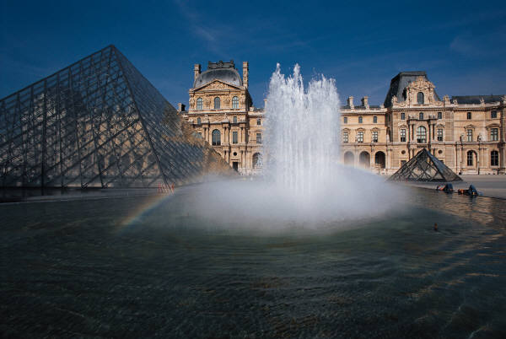
Contrast
Noticeably different
Can be created with
  Color
  Proportion and scale
  Shape
  Texture
  Etc.
©iStockphoto.com

Slide 40
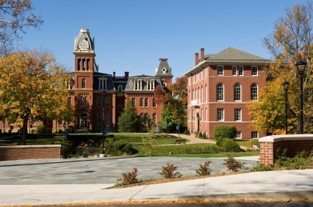
Unity
Unity is achieved by the consistent use of lines, color, material, and/or texture within a design.
©iStockphoto.com
©iStockphoto.com
Notes:
Many colleges achieve a sense of unity throughout the campus by consistently using specific materials. West Virginia University in Morgantown uses red brick. Notice that the red brick used in the buildings is also used in the landscape walls in the foreground.
In the image on the right, unity is achieved in the home interior by a consistent use of color (yellow and white) and smooth texture.

Slide 41


Unity
©iStockphoto.com
©iStockphoto.com
Microsoft Office clipart
Notes:
What elements unify each of these designs?
In the first image, the consistent use of curved roofs, color, rectangular openings, and similar potted plants create a unified design.
Although the multiple colors of Saint Basil’s Cathedral is somewhat distracting, the consistent use of onion domes and arches create a sense of unity.
[click] Unity is created in the Taj Mahal design by the consistent use of color, forms, and shapes. In addition, the entire site is unified by straight pathways that lead to the mausoleum.

Slide 42
Image Resources
Microsoft, Inc. (2008). Clip art. Retrieved January 7, 2009, from http://office. microsoft.com/en-us/clipart/default.aspx
Wikipedia. Retrieved January 7, 2009, from http://en.wikipedia.org
iStockphoto. Retrieved January 7, 2009 from http://www.istockphoto.com/index.php

Slide 43
References
The Empire State Building Official Internet Site (n.d.). Retrieved January 7, 2009, from http://www.esbnyc.com/
Great Buildings. (2009). Retrieved January 7, 2009, from www.greatbuildings.com.
Heart Castle – Hearst San Simeon State Historical Monument. (2009). Retrieved January 7, 2009, from www.hearstcastle.org

