Slide 1
Design Considerations for Manufacturability
Mass Properties and Choosing Materials
Computer Integrated Manufacturing
© 2013 Project Lead The Way, Inc.

Slide 2
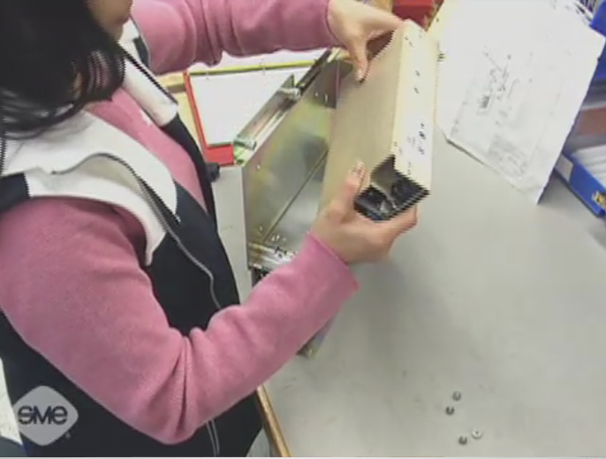
Design for Manufacture & Assembly Video
Notes:
Play Video: Design for Manufacture & Assembly

Slide 3
Mass Properties
Volume – How much raw material must be purchased?
Surface Area – How much might it cost to coat/paint the product?
Density – How strong is the material and what machines are needed to process it?
Mass – Weight determines how much it will cost to transport the material.
Notes:
These primary mass properties are closely tied to choosing the best material to manufacture a product. How the product will function is not the only concern. Processing, post-processing, and shipping costs must be considered when designing a product.

Slide 4
Choosing Materials
Strength
Durability
Cost
Availability
Environmental impact
Finishing costs
Shipping and transport

Slide 5
Strength and Durability
Will the product be strong enough to perform its function but not be over-engineered at an increased cost?
Will the product perform over time, or is it created to have a designed life-span?
Notes:
Many times products can function correctly when made from a variety of materials. It is important not to “waste” money by specifying an unnecessarily strong or rare material. Some companies decide to design products to last a defined length of time, or choose lesser quality materials to keep the cost to the consumer low.

Slide 6
Cost and Availability
How much does the raw material cost? Will the raw material make the end product too expensive?
Is the material available or is it in limited supply? Will the raw material need to be shipped to the factory, or will it be available locally?

Slide 7
Environmental Impact
Does the manufacturing process create pollution?
What happens to the excess material from manufacturing and the product at the end of its lifecycle?
Notes:
Making ethical materials choices is often more expensive for the manufacturer. Plastic has become common because it is inexpensive and has many desirable characteristics, but it is currently only possible to recycle a small amount of the many types of plastic.
Manufacturing facilities always look for ways to recycle or reclaim excess material from the production processes. Scrap metal recycling is very common. Companies exist for the sole purpose of buying scraps back from facilities that collect metal shavings and leftover metal parts. (http://www.nysun.com/pics/8189.jpg)

Slide 8
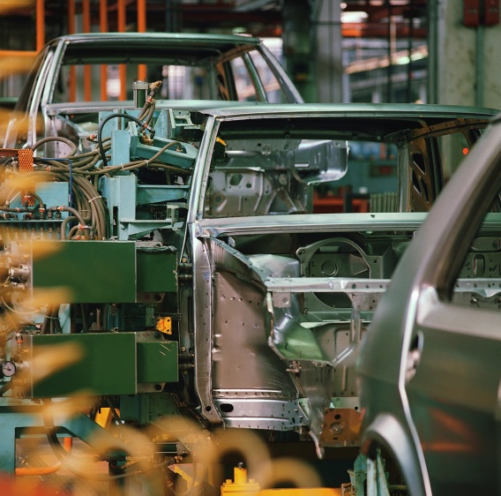
Shipping and Transport Costs
How much does the product weigh? Lighter parts are less expensive to ship.
What equipment is required to move and manipulate the parts during manufacturing?
Notes:
Shipping cost are a product of weight and volume, which are costs that must be figured into the price passed on to the consumer.
Depending on the size and weight of the raw materials and end products, expensive specialized equipment such as forklifts, conveyors, and AGVs may be necessary.

Slide 9
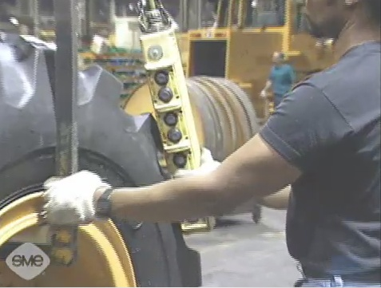
Ergonomic Safety Video
Notes:
Play Video: Ergonomic Safety

Slide 10
Image References
Microsoft, Inc. (2009). Clip Art. Retrieved from http://office.microsoft.com/en-us/clipart/default.aspx
Society of Manufacturing Engineers (Producer). (2010). Ergonomic safety. Available from the Society of Manufacturing Engineers, One SME Drive: Dearborn, Michigan 48121.

