Slide 1
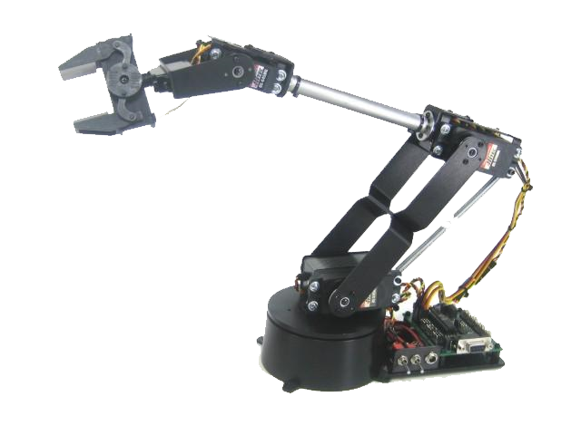
Lynxmotion Robotic Arm
http://www.lynxmotion.com/images
Computer Integrated Manufacturing
© 2016 Project Lead The Way, Inc.

Slide 2
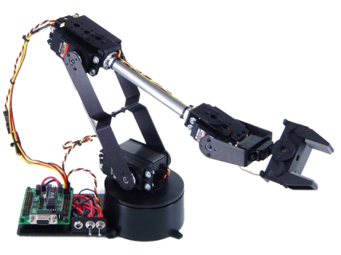
Introduction
The AL5 series robotic arm is a five or six axis jointed arm-type robot driven by four to five servo motors. It uses a serial servo controller to control all motion.
http://www.lynxmotion.com/images
Notes:
In Lesson 3.1 you learned about the different types of robots, their work envelopes, and their applications.

Slide 3
Joints
Elbow
Wrist
Wrist Rotate
Gripper
Shoulder
Base
http://www.lynxmotion.com/images

Slide 4
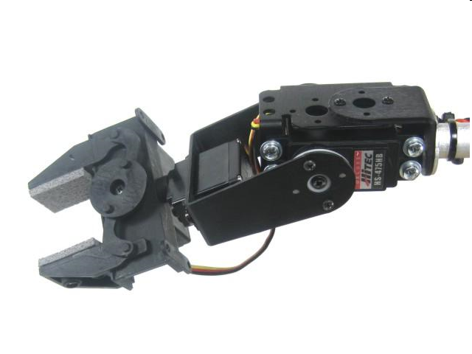
End Effector
http://www.lynxmotion.com/images
An end effector is a device or tool connected to the end of a robot arm.
The Lynxmotion gripper is shown above.
Notes:
Other common types of end effectors are welders for cutting and joining operations, vacuum grippers for accurate pick and place operations, and sprayers for applications of sealers and paints.

Slide 5
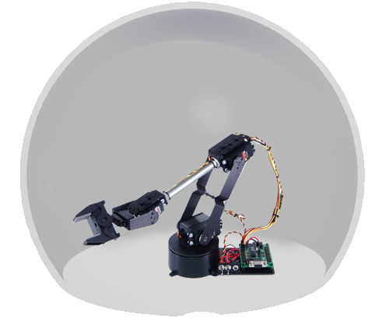
Work Envelope
The work envelope is spherical like the Scorbot and other jointed arm robots.

Slide 6
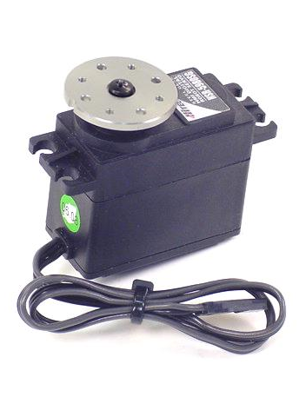
Servos
Servos are electromechanical devices that use feedback to provide precise movement of the robot’s joints.
http://www.lynxmotion.com/images

Slide 7
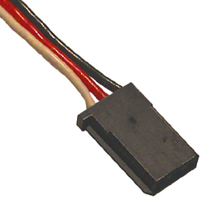
Servos: Wiring
Power is provided by the red and black wires.
Controller sends a pulse using the yellow wire to indicate which direction to turn and for how long.
http://www.lynxmotion.com/images

Slide 8
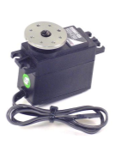
Servos: Operation
SSC-32 sends a pulse to the servo motor on the yellow wire.
A pulse of 1.5msec moves the servo to its center position.
A pulse of 1msec moves the servo 360° counterclockwise, and a 2 msec pulse moves the servo 360° clockwise.
These values are approximate.
Notes:
There are two versions of the Lynxmotion controller: SSC-32 and SSC-32U.
The SSC-32 uses a serial cable for communication between the controller and a computer.
The SSC-32U uses a USC cable for communication between the controller and a computer.

Slide 9
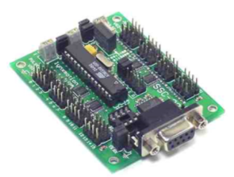
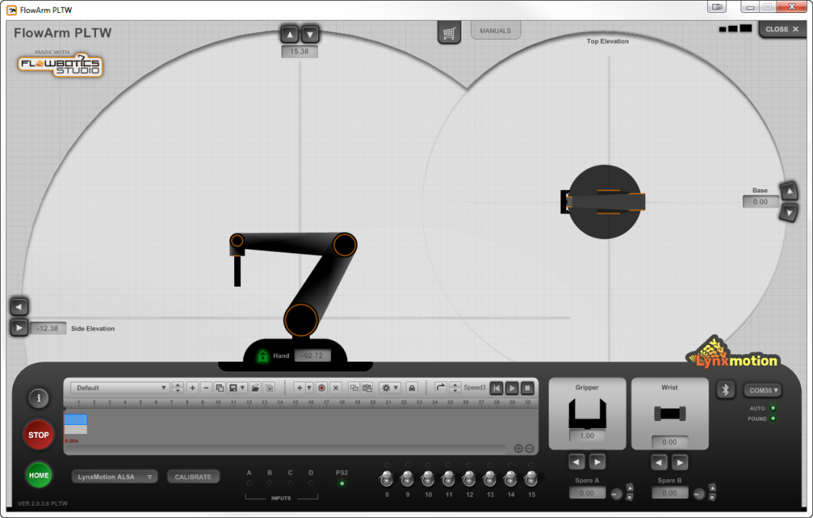
Servos: Operation
SSC-32 controller moves each servo.
FlowArm software is the interface that makes complex moves easier to perform.

Slide 10
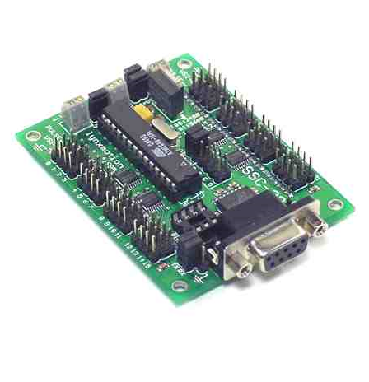
SSC-32 Interface
SSC-32 is a serial servo controller that provides the interface between the robot and the computer.
It can be used to control up to 32 servos.

Slide 11
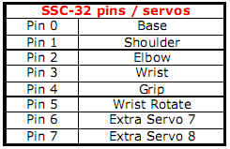
Outputs: Servos
Pins 0-7 are reserved for robot servos.

Slide 12
Outputs
Pins 8-15 are reserved for outputs and can be used to send information to other equipment.

Slide 13
Inputs
Pins A-D are reserved for inputs and can be used to monitor switches and sensors.

Slide 14
Servo Connections
Always check polarity when wires are attached to the SSC-32, and never attach wires while the board is powered on.
Black servo wire to Ground
Red servo wire to VS1 pin
Yellow servo wire to PULSE pin
Notes:
Unplug the unit from the wall and disconnect 9V battery before making any connections.

Slide 15
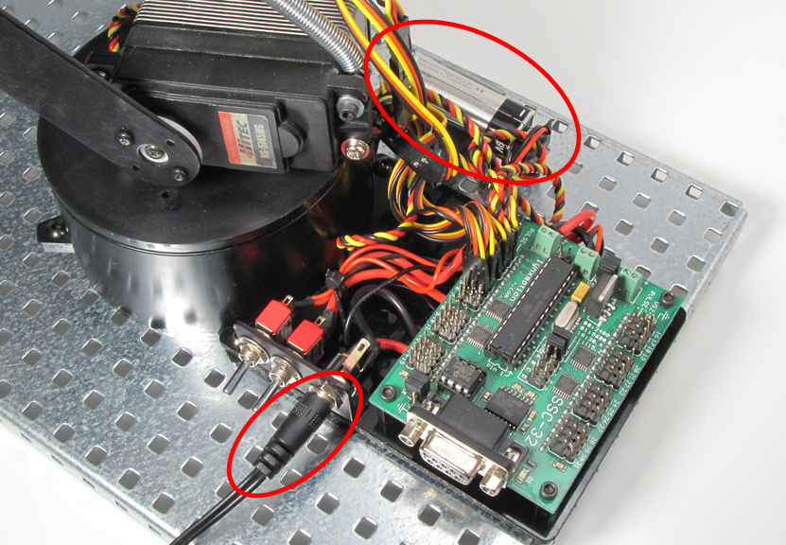
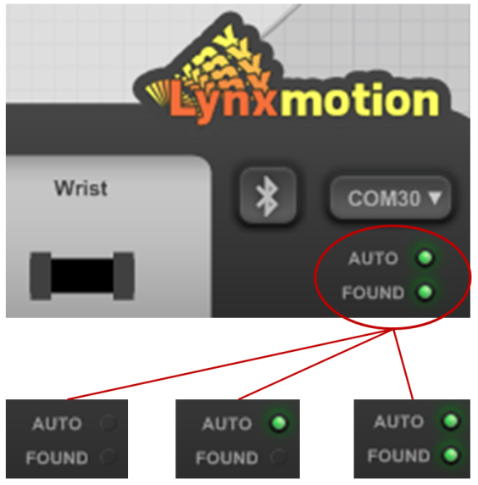
Lynxmotion Robotic Arm Start Up and Shut Down Procedures
Refer to this resource for proper operation:
Lesson 3.3 Lynxmotion Robotic Arm Start Up and Shut Down Procedures
Notes:
Lesson 3.3 Lynxmotion Robotic Arm Start Up and Shut Down Procedures is provided as a reference for proper use of the robotic arm.

